Slide 1
Household Modeling Prototype
Multiple Villages

Slide 2
Multiple Villages
0.015
-0.025
-0.020
-0.015
-0.010
-0.005
0.000
0.005
0.010
0.015
0.020
0.025
0.025
Vulcan
Nodes: 16
Vulcans: 76
Kronos
Nodes: 24
Klingons: 205
0.020
TOTAL
Nodes: 100
People: 520
Vectors: 15250
0.015
0.010
0.005
Mountains
Nodes: 8
People: 0
Vectors: 0
LHM: 0
Larval Habitat
Nodes: 20
People: 0
Vectors: 400 each
LHM: 10 each
0.000
-0.005
Andoria
Nodes: 23
Andorians: 139
-0.010
SEA
Nodes: 8
People: 0
Vectors: 0
LHM: 0
-0.015
-0.020
Earth
100
People: 100
Vectors: 1000
LHM: 20
-0.025

Slide 3
Multiple Villages - Larval Habitat
0.015
-0.025
-0.020
-0.015
-0.010
-0.005
0.000
0.005
0.010
0.015
0.020
0.025
0.025
1
People: 15
Vectors: 50
LHM: 0.5
2
People: 1
Vectors: 100
LHM: 1
3
People: 5
Vectors: 100
LHM: 1
4
People: 5
Vectors: 200
LHM: 5
5
People: 0
Vectors: 400
LHM: 10
6
People: 0
Vectors: 400
LHM: 10
7
People: 15
Vectors: 200
LHM: 5
8
People: 5
Vectors: 100
LHM: 1
9
People: 1
Vectors: 100
LHM: 1
10
People: 10
Vectors: 50
LHM: 0.5
0.020
11
People: 1
Vectors: 50
LHM: 0.5
12
People: 1
Vectors: 100
LHM: 1
13
People: 5
Vectors: 100
LHM: 1
14
People: 5
Vectors: 200
LHM: 5
15
People: 0
Vectors: 400
LHM: 10
16
People: 0
Vectors: 400
LHM: 10
17
People: 15
Vectors: 200
LHM: 5
18
People: 5
Vectors: 100
LHM: 1
19
People: 1
Vectors: 100
LHM: 1
20
People: 10
Vectors: 50
LHM: 0.5
0.015
21
People: 5
Vectors: 50
LHM: 0.5
22
People: 5
Vectors: 100
LHM: 1
23
People: 1
Vectors: 100
LHM: 1
24
People: 1
Vectors: 200
LHM: 5
25
People: 0
Vectors: 400
LHM: 10
26
People: 0
Vectors: 400
LHM: 10
27
People: 15
Vectors: 200
LHM: 5
28
People: 5
Vectors: 100
LHM: 1
29
People: 1
Vectors: 100
LHM: 1
30
People: 10
Vectors: 50
LHM: 0.5
0.010
31
People: 5
Vectors: 50
LHM: 0.5
32
People: 5
Vectors: 100
LHM: 1
33
People: 1
Vectors: 100
LHM: 1
34
People: 15
Vectors: 200
LHM: 5
35
People: 0
Vectors: 400
LHM: 10
36
People: 0
Vectors: 400
LHM: 10
37
People: 15
Vectors: 200
LHM: 5
38
People: 5
Vectors: 100
LHM: 1
39
People: 1
Vectors: 100
LHM: 1
40
People: 1
Vectors: 100
LHM: 1
0.005
41
People: 0
Vectors: 0
LHM: 0
42
People: 0
Vectors: 0
LHM: 0
43
People: 0
Vectors: 0
LHM: 0
44
People: 0
Vectors: 0
LHM: 0
45
People: 0
Vectors: 400
LHM: 10
46
People: 0
Vectors: 400
LHM: 10
47
People: 15
Vectors: 200
LHM: 5
48
People: 5
Vectors: 100
LHM: 1
49
People: 5
Vectors: 100
LHM: 1
50
People: 5
Vectors: 100
LHM: 1
0.000
51
People: 0
Vectors: 0
LHM: 0
52
People: 0
Vectors: 0
LHM: 0
53
People: 0
Vectors: 0
LHM: 0
54
People: 0
Vectors: 0
LHM: 0
55
People: 0
Vectors: 400
LHM: 10
56
People: 0
Vectors: 400
LHM: 10
57
People: 15
Vectors: 200
LHM: 5
58
People: 15
Vectors: 200
LHM: 5
59
People: 15
Vectors: 200
LHM: 5
60
People: 15
Vectors: 200
LHM: 5
-0.005
61
People: 15
Vectors: 50
LHM: 0.5
62
People: 1
Vectors: 100
LHM: 1
63
People: 5
Vectors: 100
LHM: 1
64
People: 5
Vectors: 100
LHM: 1
65
People: 5
Vectors: 200
LHM: 5
66
People: 0
Vectors: 400
LHM: 10
67
People: 0
Vectors: 400
LHM: 10
68
People: 0
Vectors: 400
LHM: 10
69
People: 0
Vectors: 400
LHM: 10
70
People: 0
Vectors: 400
LHM: 10
-0.010
71
People: 15
Vectors: 50
LHM: 0.5
72
People: 1
Vectors: 50
LHM: 0.5
73
People: 5
Vectors: 100
LHM: 1
74
People: 5
Vectors: 100
LHM: 1
75
People: 5
Vectors: 100
LHM: 1
76
People: 5
Vectors: 200
LHM: 5
77
People: 0
Vectors: 400
LHM: 10
78
People: 0
Vectors: 0
LHM: 0
79
People: 0
Vectors: 0
LHM: 0
80
People: 0
Vectors: 0
LHM: 0
-0.015
81
People: 15
Vectors: 50
LHM: 0.5
82
People: 1
Vectors: 50
LHM: 0.5
83
People: 5
Vectors: 100
LHM: 1
84
People: 5
Vectors: 100
LHM: 1
85
People: 5
Vectors: 100
LHM: 1
86
People: 5
Vectors: 200
LHM: 5
87
People: 0
Vectors: 400
LHM: 10
88
People: 0
Vectors: 0
LHM: 0
89
People: 0
Vectors: 0
LHM: 0
90
People: 0
Vectors: 0
LHM: 0
-0.020
91
People: 15
Vectors: 50
LHM: 0.5
92
People: 1
Vectors: 50
LHM: 0.5
93
People: 5
Vectors: 100
LHM: 1
94
People: 5
Vectors: 100
LHM: 1
95
People: 5
Vectors: 100
LHM: 1
96
People: 5
Vectors: 200
LHM: 5
97
People: 0
Vectors: 400
LHM: 10
98
People: 0
Vectors: 0
LHM: 0
99
People: 0
Vectors: 0
LHM: 0
100
People: 100
Vectors: 1000
LHM: 20
Work Node
-0.025

Slide 4
Multiple Villages - People
0.015
-0.025
-0.020
-0.015
-0.010
-0.005
0.000
0.005
0.010
0.015
0.020
0.025
0.025
1
People: 15
Vectors: 50
LHM: 0.5
2
People: 1
Vectors: 100
LHM: 1
3
People: 5
Vectors: 100
LHM: 1
4
People: 5
Vectors: 200
LHM: 5
5
People: 0
Vectors: 400
LHM: 10
6
People: 0
Vectors: 400
LHM: 10
7
People: 15
Vectors: 200
LHM: 5
8
People: 5
Vectors: 100
LHM: 1
9
People: 1
Vectors: 100
LHM: 1
10
People: 10
Vectors: 50
LHM: 0.5
0.020
11
People: 1
Vectors: 50
LHM: 0.5
12
People: 1
Vectors: 100
LHM: 1
13
People: 5
Vectors: 100
LHM: 1
14
People: 5
Vectors: 200
LHM: 5
15
People: 0
Vectors: 400
LHM: 10
16
People: 0
Vectors: 400
LHM: 10
17
People: 15
Vectors: 200
LHM: 5
18
People: 5
Vectors: 100
LHM: 1
19
People: 1
Vectors: 100
LHM: 1
20
People: 10
Vectors: 50
LHM: 0.5
0.015
21
People: 5
Vectors: 50
LHM: 0.5
22
People: 5
Vectors: 100
LHM: 1
23
People: 1
Vectors: 100
LHM: 1
24
People: 1
Vectors: 200
LHM: 5
25
People: 0
Vectors: 400
LHM: 10
26
People: 0
Vectors: 400
LHM: 10
27
People: 15
Vectors: 200
LHM: 5
28
People: 5
Vectors: 100
LHM: 1
29
People: 1
Vectors: 100
LHM: 1
30
People: 10
Vectors: 50
LHM: 0.5
0.010
31
People: 5
Vectors: 50
LHM: 0.5
32
People: 5
Vectors: 100
LHM: 1
33
People: 1
Vectors: 100
LHM: 1
34
People: 15
Vectors: 200
LHM: 5
35
People: 0
Vectors: 400
LHM: 10
36
People: 0
Vectors: 400
LHM: 10
37
People: 15
Vectors: 200
LHM: 5
38
People: 5
Vectors: 100
LHM: 1
39
People: 1
Vectors: 100
LHM: 1
40
People: 1
Vectors: 100
LHM: 1
0.005
41
People: 0
Vectors: 0
LHM: 0
42
People: 0
Vectors: 0
LHM: 0
43
People: 0
Vectors: 0
LHM: 0
44
People: 0
Vectors: 0
LHM: 0
45
People: 0
Vectors: 400
LHM: 10
46
People: 0
Vectors: 400
LHM: 10
47
People: 15
Vectors: 200
LHM: 5
48
People: 5
Vectors: 100
LHM: 1
49
People: 5
Vectors: 100
LHM: 1
50
People: 5
Vectors: 100
LHM: 1
0.000
51
People: 0
Vectors: 0
LHM: 0
52
People: 0
Vectors: 0
LHM: 0
53
People: 0
Vectors: 0
LHM: 0
54
People: 0
Vectors: 0
LHM: 0
55
People: 0
Vectors: 400
LHM: 10
56
People: 0
Vectors: 400
LHM: 10
57
People: 15
Vectors: 200
LHM: 5
58
People: 15
Vectors: 200
LHM: 5
59
People: 15
Vectors: 200
LHM: 5
60
People: 15
Vectors: 200
LHM: 5
-0.005
61
People: 15
Vectors: 50
LHM: 0.5
62
People: 1
Vectors: 100
LHM: 1
63
People: 5
Vectors: 100
LHM: 1
64
People: 5
Vectors: 100
LHM: 1
65
People: 5
Vectors: 200
LHM: 5
66
People: 0
Vectors: 400
LHM: 10
67
People: 0
Vectors: 400
LHM: 10
68
People: 0
Vectors: 400
LHM: 10
69
People: 0
Vectors: 400
LHM: 10
70
People: 0
Vectors: 400
LHM: 10
-0.010
71
People: 15
Vectors: 50
LHM: 0.5
72
People: 1
Vectors: 50
LHM: 0.5
73
People: 5
Vectors: 100
LHM: 1
74
People: 5
Vectors: 100
LHM: 1
75
People: 5
Vectors: 100
LHM: 1
76
People: 5
Vectors: 200
LHM: 5
77
People: 0
Vectors: 400
LHM: 10
78
People: 0
Vectors: 0
LHM: 0
79
People: 0
Vectors: 0
LHM: 0
80
People: 0
Vectors: 0
LHM: 0
-0.015
81
People: 15
Vectors: 50
LHM: 0.5
82
People: 1
Vectors: 50
LHM: 0.5
83
People: 5
Vectors: 100
LHM: 1
84
People: 5
Vectors: 100
LHM: 1
85
People: 5
Vectors: 100
LHM: 1
86
People: 5
Vectors: 200
LHM: 5
87
People: 0
Vectors: 400
LHM: 10
88
People: 0
Vectors: 0
LHM: 0
89
People: 0
Vectors: 0
LHM: 0
90
People: 0
Vectors: 0
LHM: 0
-0.020
91
People: 15
Vectors: 50
LHM: 0.5
92
People: 1
Vectors: 50
LHM: 0.5
93
People: 5
Vectors: 100
LHM: 1
94
People: 5
Vectors: 100
LHM: 1
95
People: 5
Vectors: 100
LHM: 1
96
People: 5
Vectors: 200
LHM: 5
97
People: 0
Vectors: 400
LHM: 10
98
People: 0
Vectors: 0
LHM: 0
99
People: 0
Vectors: 0
LHM: 0
100
People: 100
Vectors: 1000
LHM: 20
Work Node
-0.025

Slide 5
Multiple Villages
0.015
-0.025
-0.020
-0.015
-0.010
-0.005
0.000
0.005
0.010
0.015
0.020
0.025
0.025
1
People: 15
Vectors: 50
LHM: 0.5
2
People: 1
Vectors: 100
LHM: 1
3
People: 5
Vectors: 100
LHM: 1
4
People: 5
Vectors: 200
LHM: 5
5
People: 0
Vectors: 400
LHM: 10
6
People: 0
Vectors: 400
LHM: 10
7
People: 15
Vectors: 200
LHM: 5
8
People: 5
Vectors: 100
LHM: 1
9
People: 1
Vectors: 100
LHM: 1
10
People: 10
Vectors: 50
LHM: 0.5
0.020
11
People: 1
Vectors: 50
LHM: 0.5
12
People: 1
Vectors: 100
LHM: 1
13
People: 5
Vectors: 100
LHM: 1
14
People: 5
Vectors: 200
LHM: 5
15
People: 0
Vectors: 400
LHM: 10
16
People: 0
Vectors: 400
LHM: 10
17
People: 15
Vectors: 200
LHM: 5
18
People: 5
Vectors: 100
LHM: 1
19
People: 1
Vectors: 100
LHM: 1
20
People: 10
Vectors: 50
LHM: 0.5
0.015
21
People: 5
Vectors: 50
LHM: 0.5
22
People: 5
Vectors: 100
LHM: 1
23
People: 1
Vectors: 100
LHM: 1
24
People: 1
Vectors: 200
LHM: 5
25
People: 0
Vectors: 400
LHM: 10
26
People: 0
Vectors: 400
LHM: 10
27
People: 15
Vectors: 200
LHM: 5
28
People: 5
Vectors: 100
LHM: 1
29
People: 1
Vectors: 100
LHM: 1
30
People: 10
Vectors: 50
LHM: 0.5
0.010
31
People: 5
Vectors: 50
LHM: 0.5
32
People: 5
Vectors: 100
LHM: 1
33
People: 1
Vectors: 100
LHM: 1
34
People: 15
Vectors: 200
LHM: 5
35
People: 0
Vectors: 400
LHM: 10
36
People: 0
Vectors: 400
LHM: 10
37
People: 15
Vectors: 200
LHM: 5
38
People: 5
Vectors: 100
LHM: 1
39
People: 1
Vectors: 100
LHM: 1
40
People: 1
Vectors: 100
LHM: 1
0.005
41
People: 0
Vectors: 0
LHM: 0
42
People: 0
Vectors: 0
LHM: 0
43
People: 0
Vectors: 0
LHM: 0
44
People: 0
Vectors: 0
LHM: 0
45
People: 0
Vectors: 400
LHM: 10
46
People: 0
Vectors: 400
LHM: 10
47
People: 15
Vectors: 200
LHM: 5
48
People: 5
Vectors: 100
LHM: 1
49
People: 5
Vectors: 100
LHM: 1
50
People: 5
Vectors: 100
LHM: 1
0.000
51
People: 0
Vectors: 0
LHM: 0
52
People: 0
Vectors: 0
LHM: 0
53
People: 0
Vectors: 0
LHM: 0
54
People: 0
Vectors: 0
LHM: 0
55
People: 0
Vectors: 400
LHM: 10
56
People: 0
Vectors: 400
LHM: 10
57
People: 15
Vectors: 200
LHM: 5
58
People: 15
Vectors: 200
LHM: 5
59
People: 15
Vectors: 200
LHM: 5
60
People: 15
Vectors: 200
LHM: 5
-0.005
61
People: 15
Vectors: 50
LHM: 0.5
62
People: 1
Vectors: 100
LHM: 1
63
People: 5
Vectors: 100
LHM: 1
64
People: 5
Vectors: 100
LHM: 1
65
People: 5
Vectors: 200
LHM: 5
66
People: 0
Vectors: 400
LHM: 10
67
People: 0
Vectors: 400
LHM: 10
68
People: 0
Vectors: 400
LHM: 10
69
People: 0
Vectors: 400
LHM: 10
70
People: 0
Vectors: 400
LHM: 10
-0.010
71
People: 15
Vectors: 50
LHM: 0.5
72
People: 1
Vectors: 50
LHM: 0.5
73
People: 5
Vectors: 100
LHM: 1
74
People: 5
Vectors: 100
LHM: 1
75
People: 5
Vectors: 100
LHM: 1
76
People: 5
Vectors: 200
LHM: 5
77
People: 0
Vectors: 400
LHM: 10
78
People: 0
Vectors: 0
LHM: 0
79
People: 0
Vectors: 0
LHM: 0
80
People: 0
Vectors: 0
LHM: 0
-0.015
81
People: 15
Vectors: 50
LHM: 0.5
82
People: 1
Vectors: 50
LHM: 0.5
83
People: 5
Vectors: 100
LHM: 1
84
People: 5
Vectors: 100
LHM: 1
85
People: 5
Vectors: 100
LHM: 1
86
People: 5
Vectors: 200
LHM: 5
87
People: 0
Vectors: 400
LHM: 10
88
People: 0
Vectors: 0
LHM: 0
89
People: 0
Vectors: 0
LHM: 0
90
People: 0
Vectors: 0
LHM: 0
-0.020
91
People: 15
Vectors: 50
LHM: 0.5
92
People: 1
Vectors: 50
LHM: 0.5
93
People: 5
Vectors: 100
LHM: 1
94
People: 5
Vectors: 100
LHM: 1
95
People: 5
Vectors: 100
LHM: 1
96
People: 5
Vectors: 200
LHM: 5
97
People: 0
Vectors: 400
LHM: 10
98
People: 0
Vectors: 0
LHM: 0
99
People: 0
Vectors: 0
LHM: 0
100
People: 100
Vectors: 1000
LHM: 20
Work Node
-0.025

Slide 6
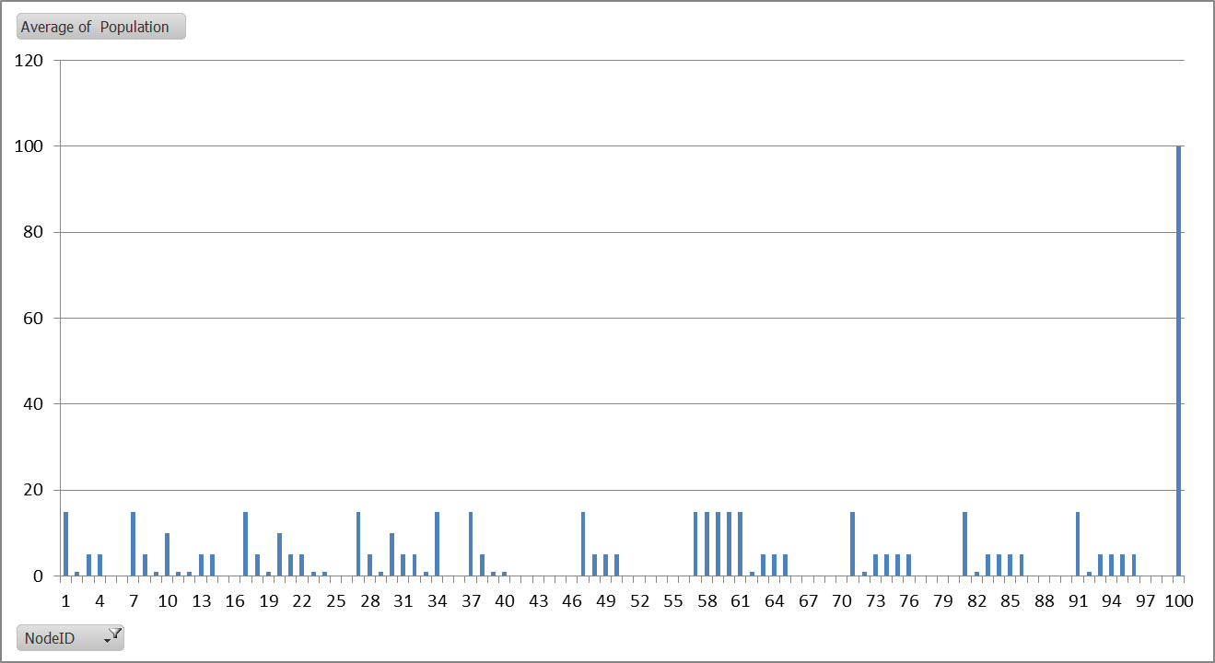
No Human or Vector Migration Average Human Population

Slide 7
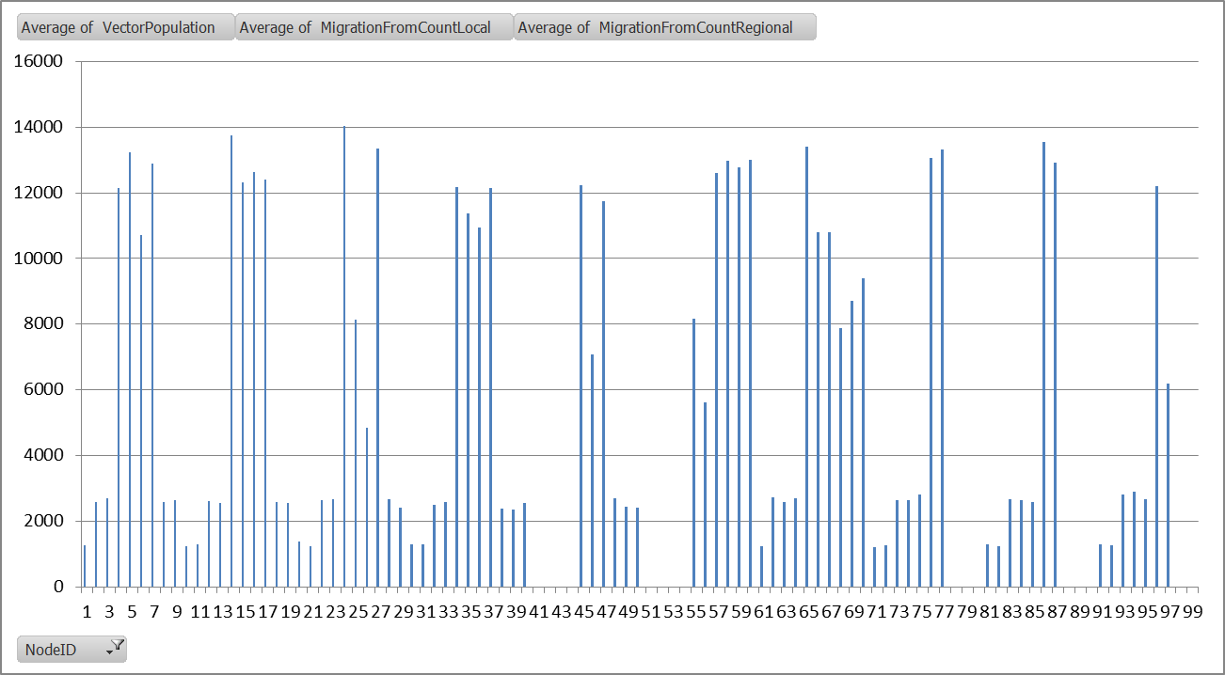
No Human or Vector Migration Average Vector Population

Slide 8
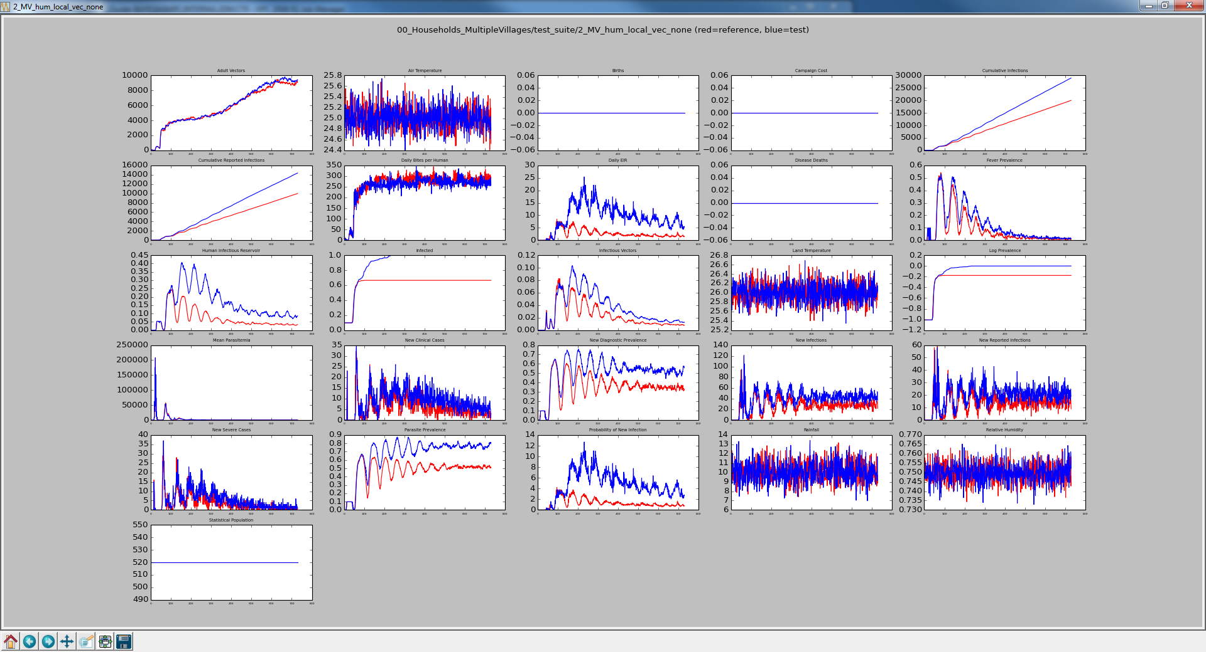
No Human/No Vector Migration vs Local Human/No Vector Migration

Slide 9
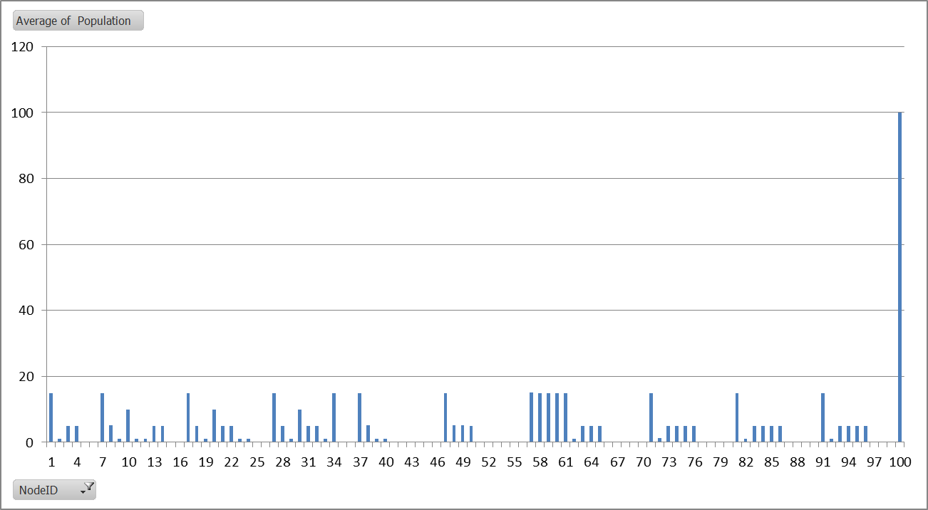
Local Human / No Vector Migration Average Human Population

Slide 10
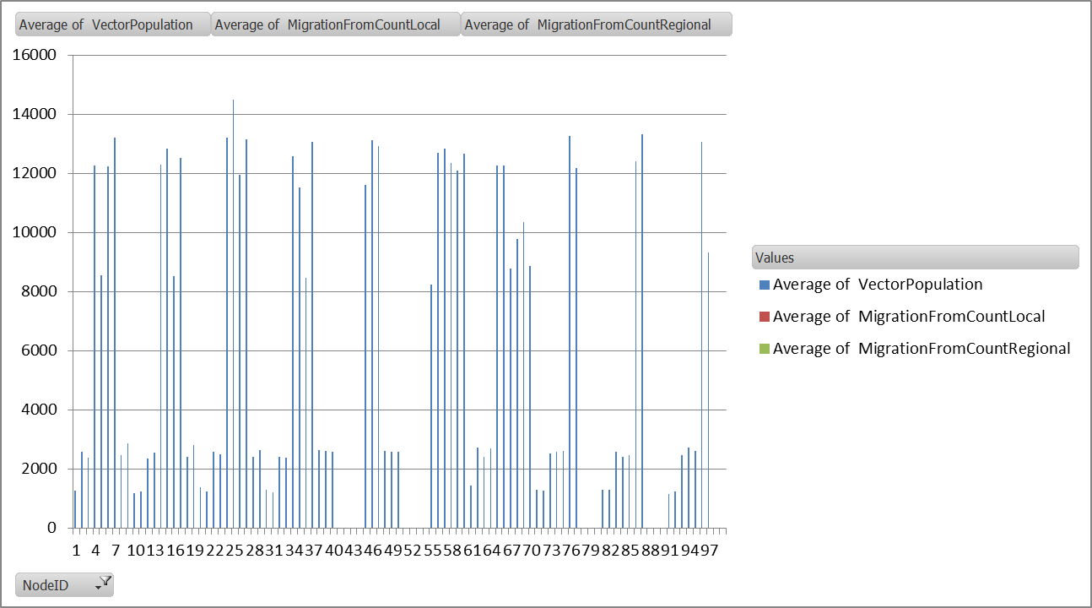
Local Human / No Vector Migration Average Vector Population

Slide 11
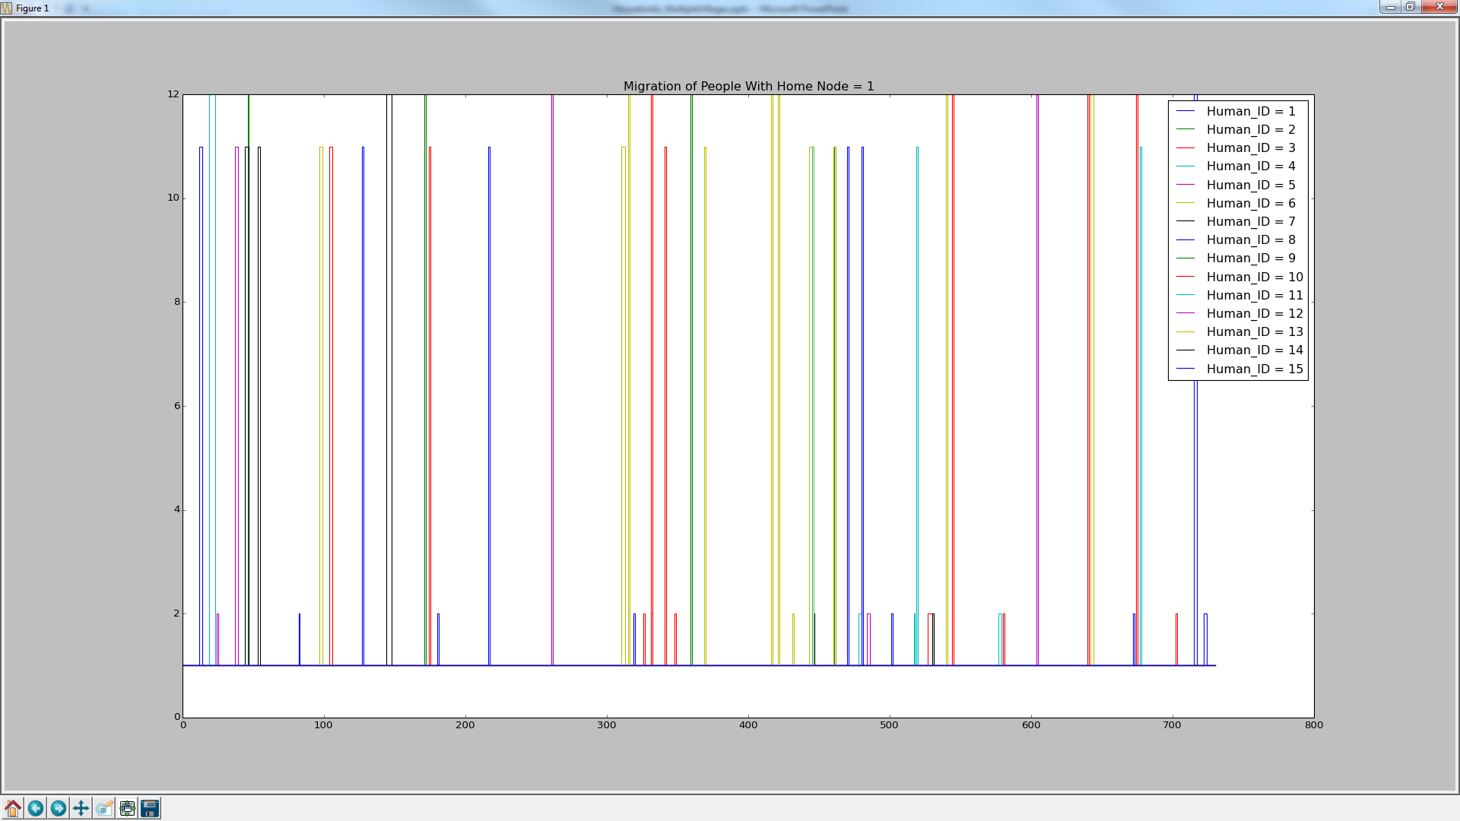
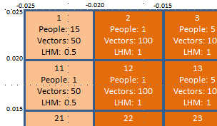
Human Migration For Node 1 Residents Local Migration
Notice that durations are very short, most are 1 day.
Visiting -12
Visiting -11
Visiting -2
Home = 1

Slide 12
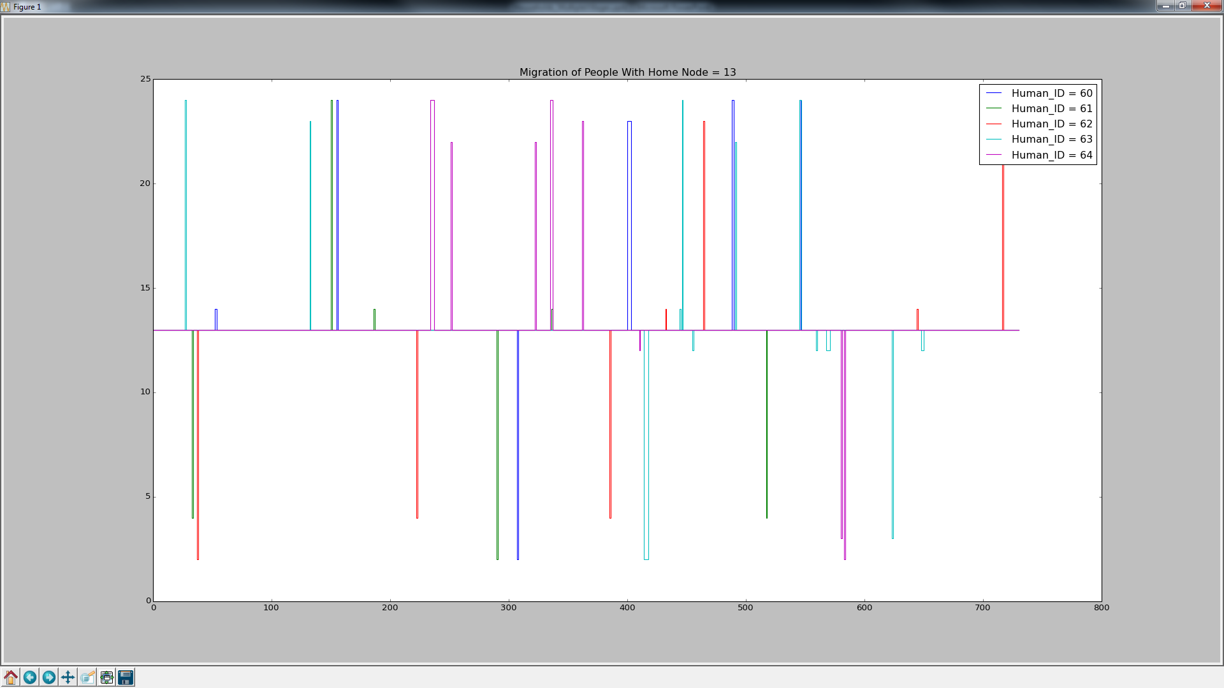
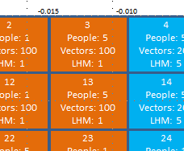
Human Migration For Node 13 Residents
Visiting – 22, 24, 23
Visiting – 14, 11
Home = 13
Visiting – 4, 3, 2

Slide 13
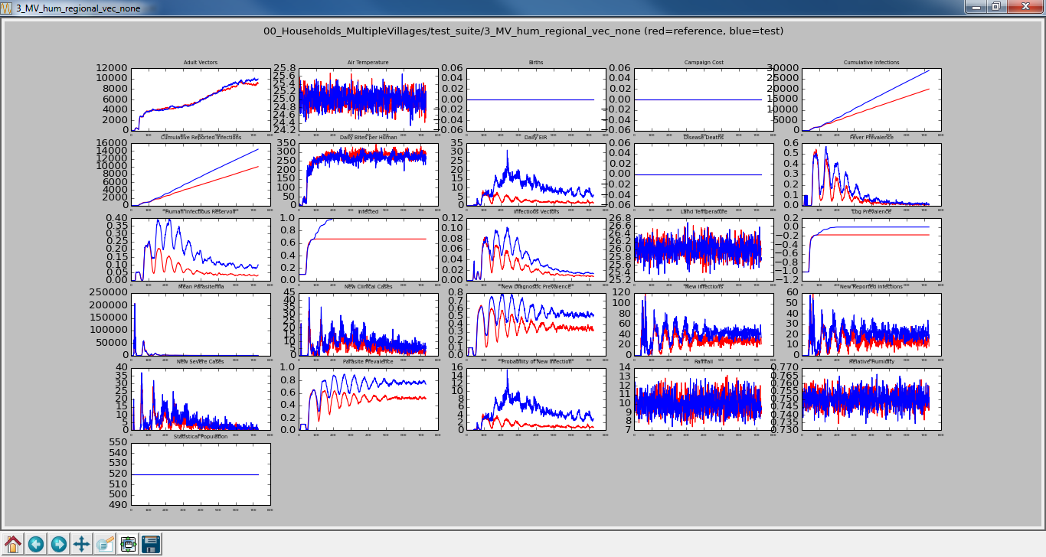
No Human/No Vector Migration vs Regional Human/No Vector Migration

Slide 14
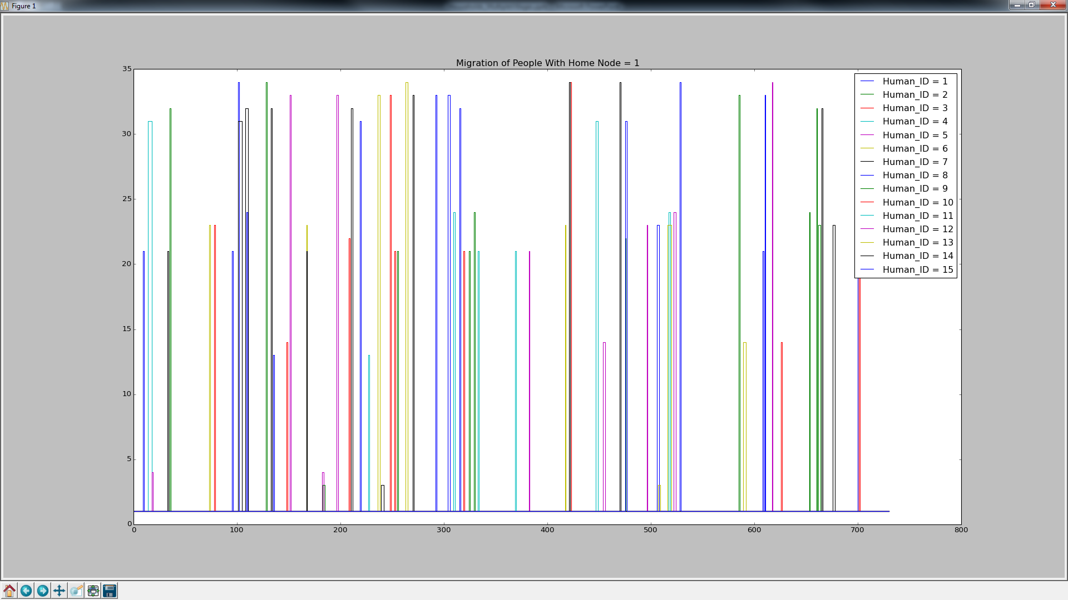
Human Migration For Node 1 Residents Regional Migration
Habitat Boundary or Other Village
Adjacent Nodes

Slide 15
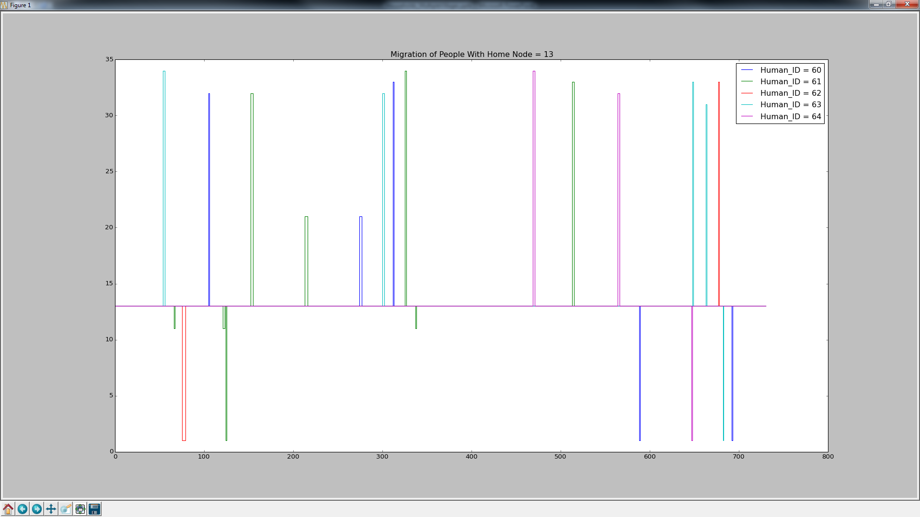
Human Migration For Node 13 Residents Regional Migration
Habitat Boundary or Other Village
Adjacent Nodes

Slide 16
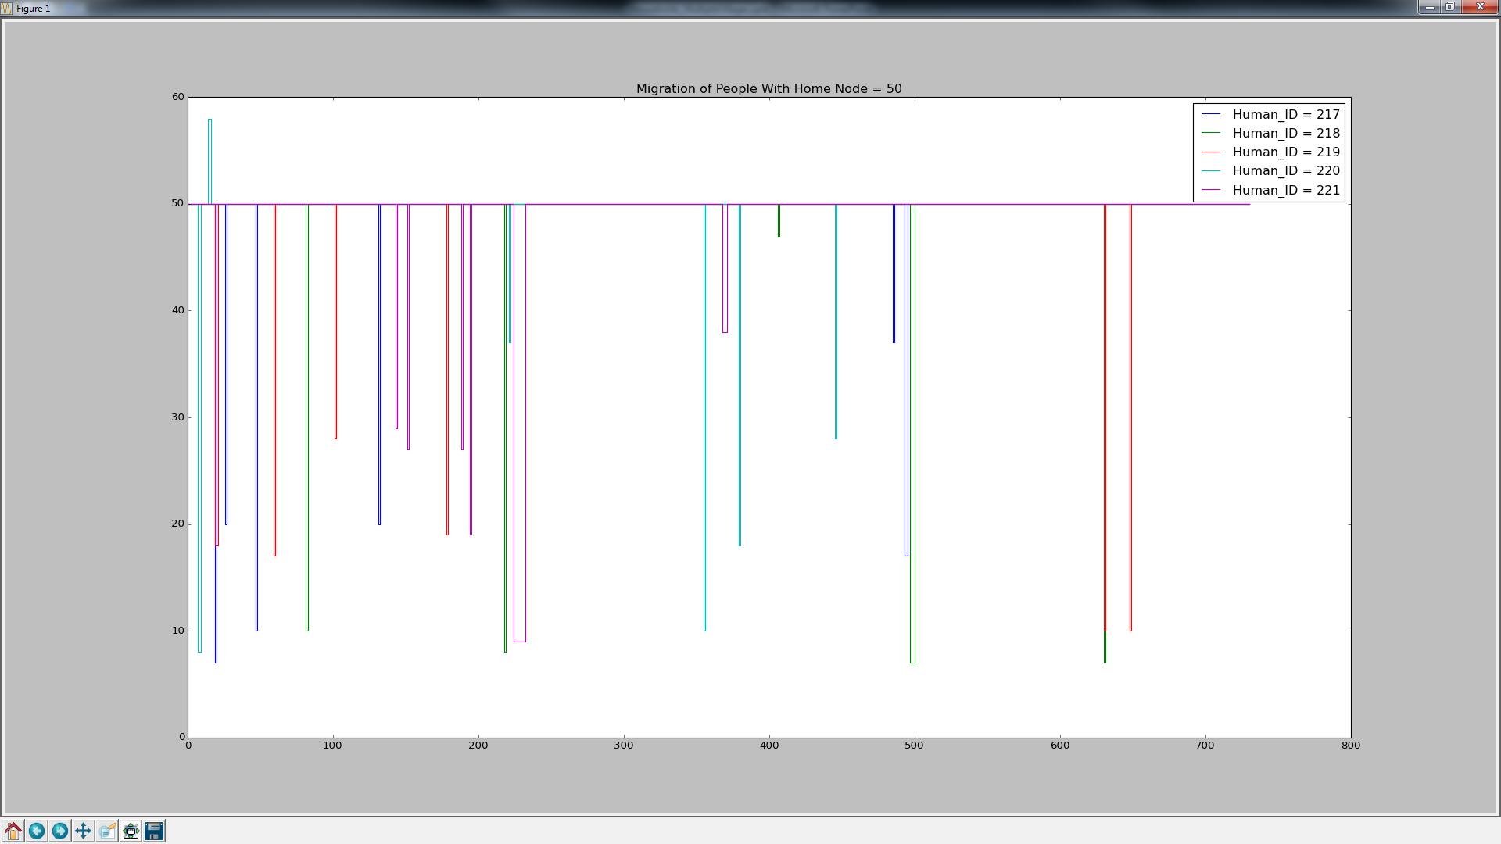
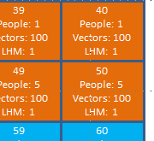
Human Migration For Node 50 Residents Regional Migration
Habitat Boundary or Other Village
Adjacent Nodes

Slide 17
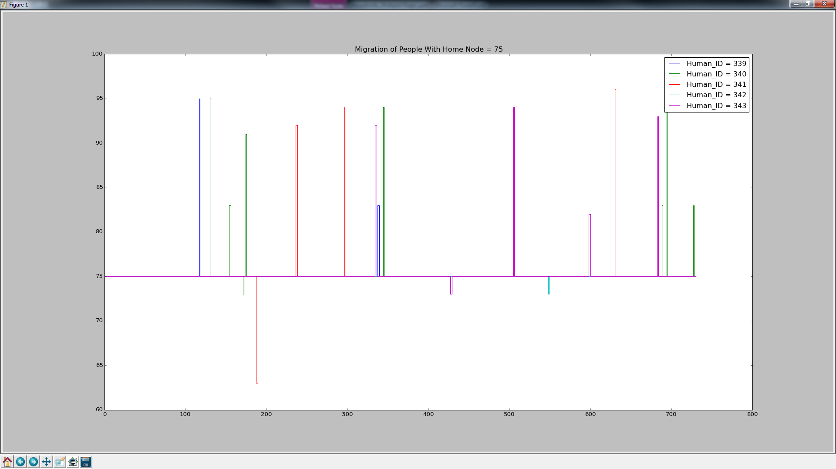
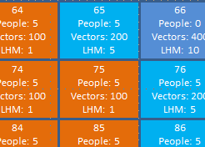
Human Migration For Node 75 Residents Regional Migration
Habitat Boundary or Other Village
Adjacent Nodes

Slide 18
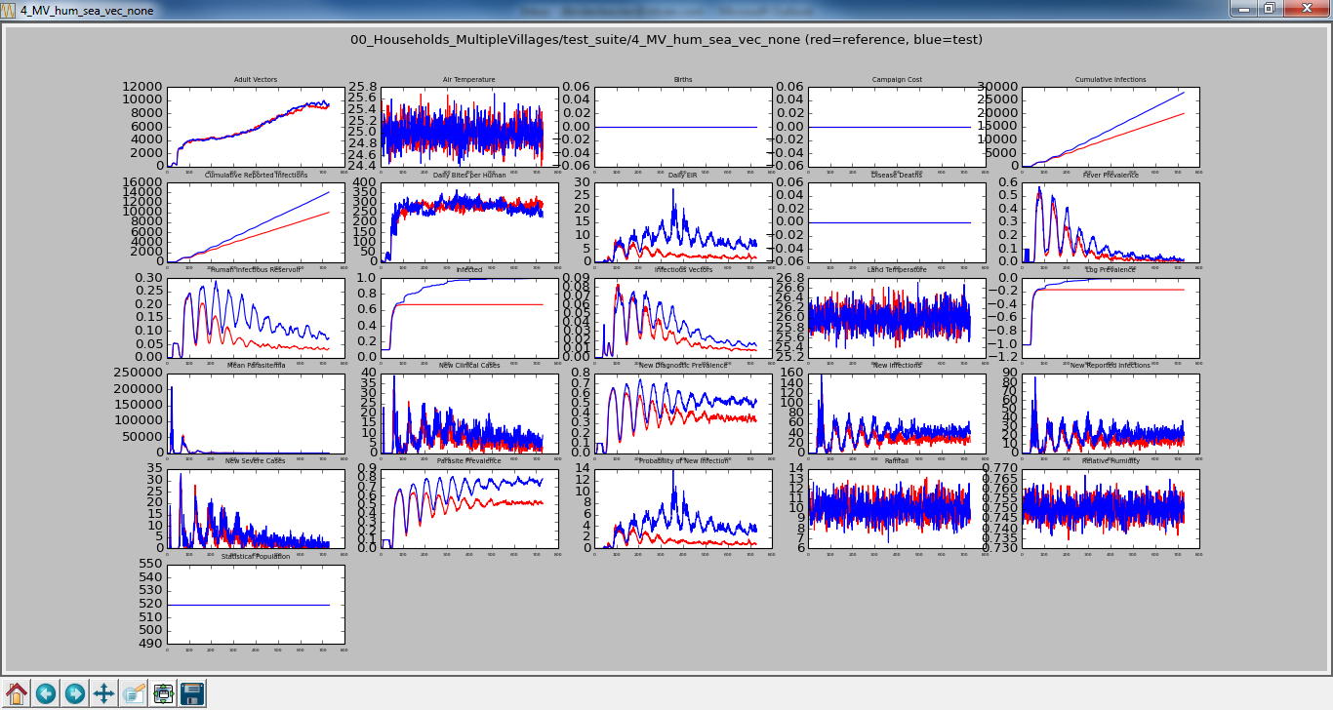
No Human/No Vector Migration vs Sea Human/No Vector Migration

Slide 19
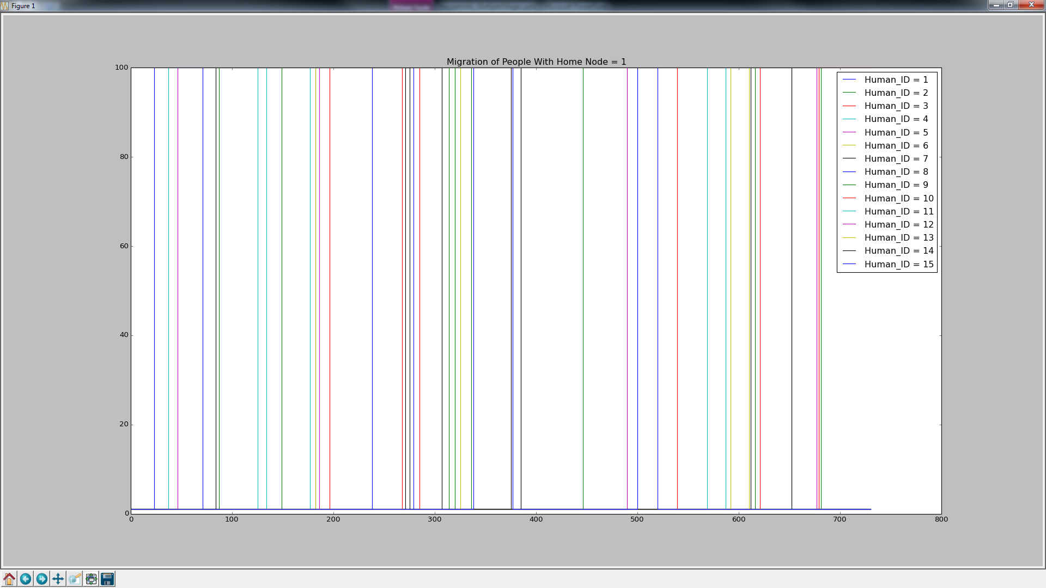
Human Migration For Node 1 Residents Sea Migration

Slide 20
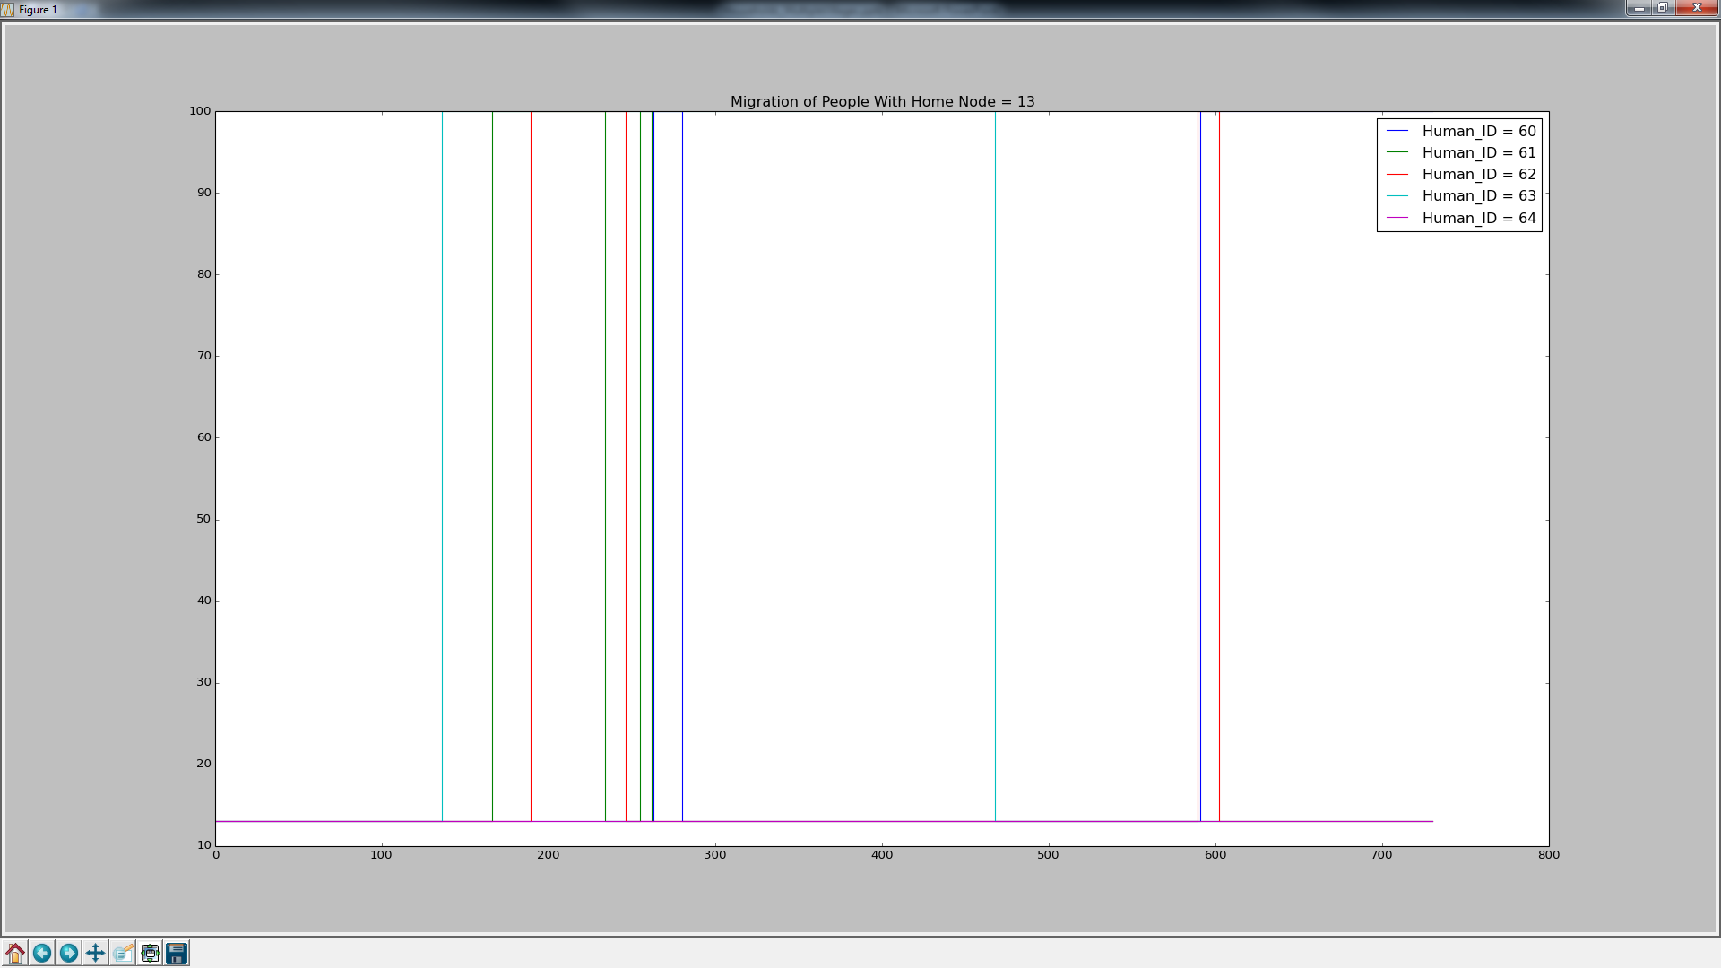
Human Migration For Node 13 Residents Sea Migration

Slide 21
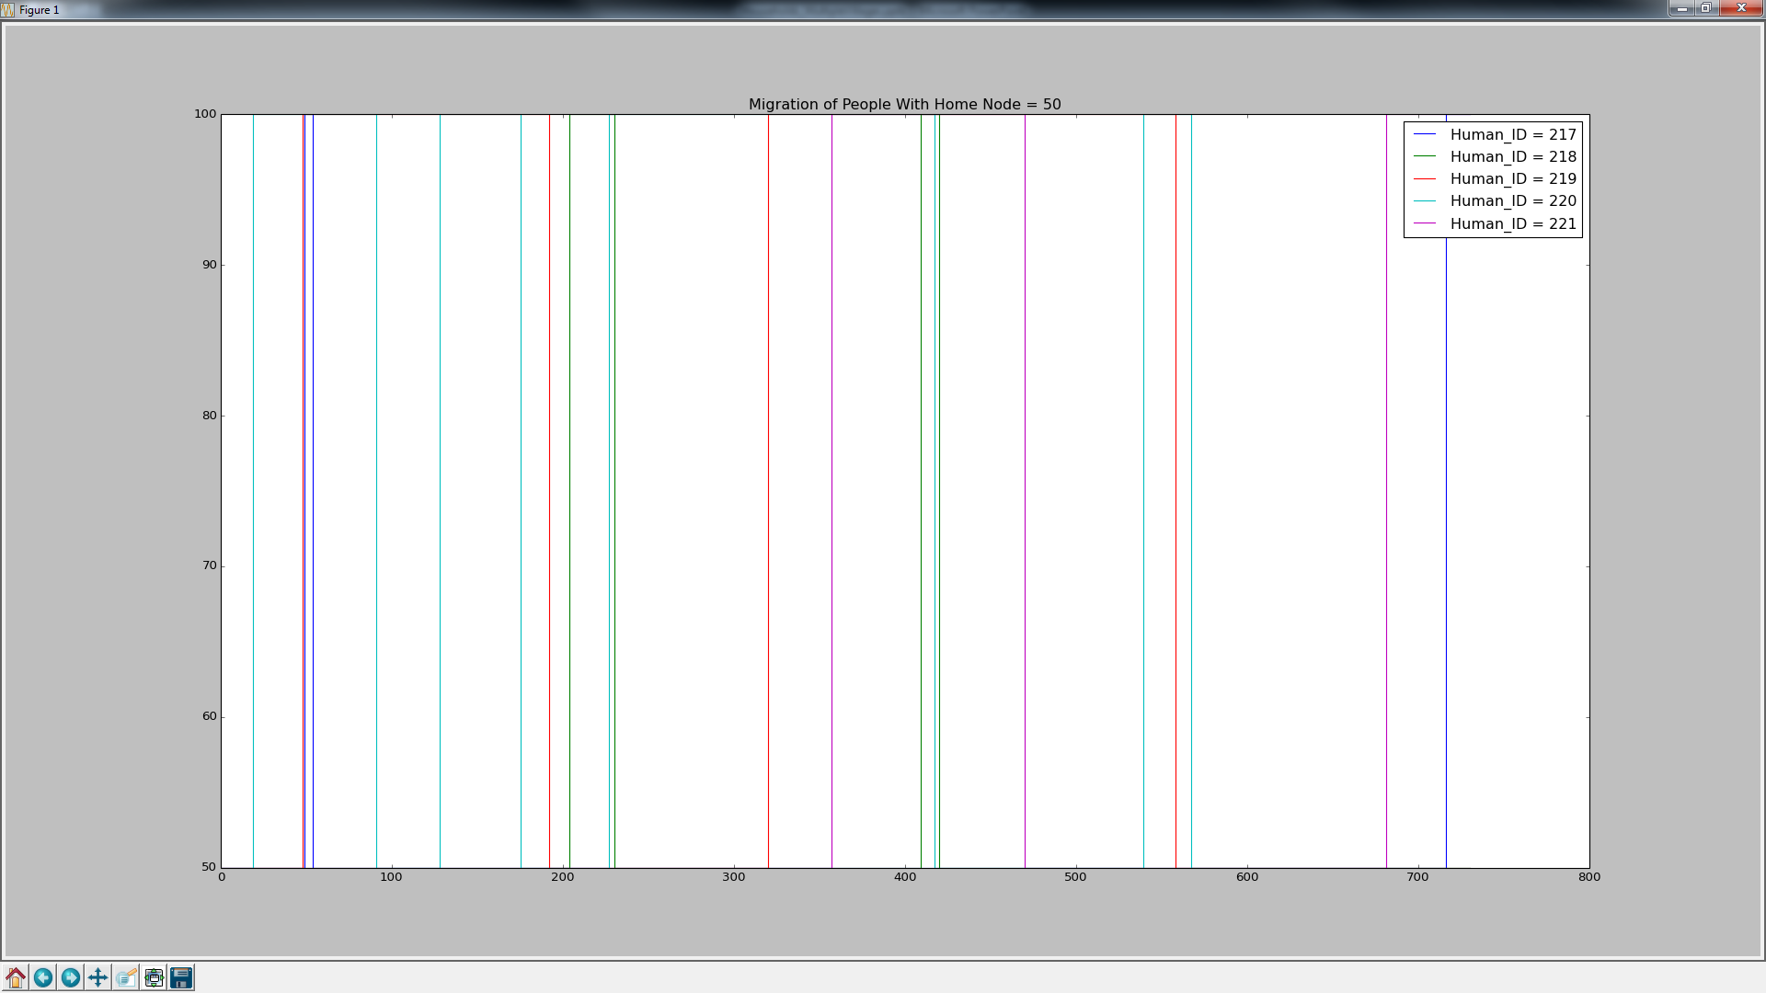
Human Migration For Node 50 Residents Sea Migration

Slide 22
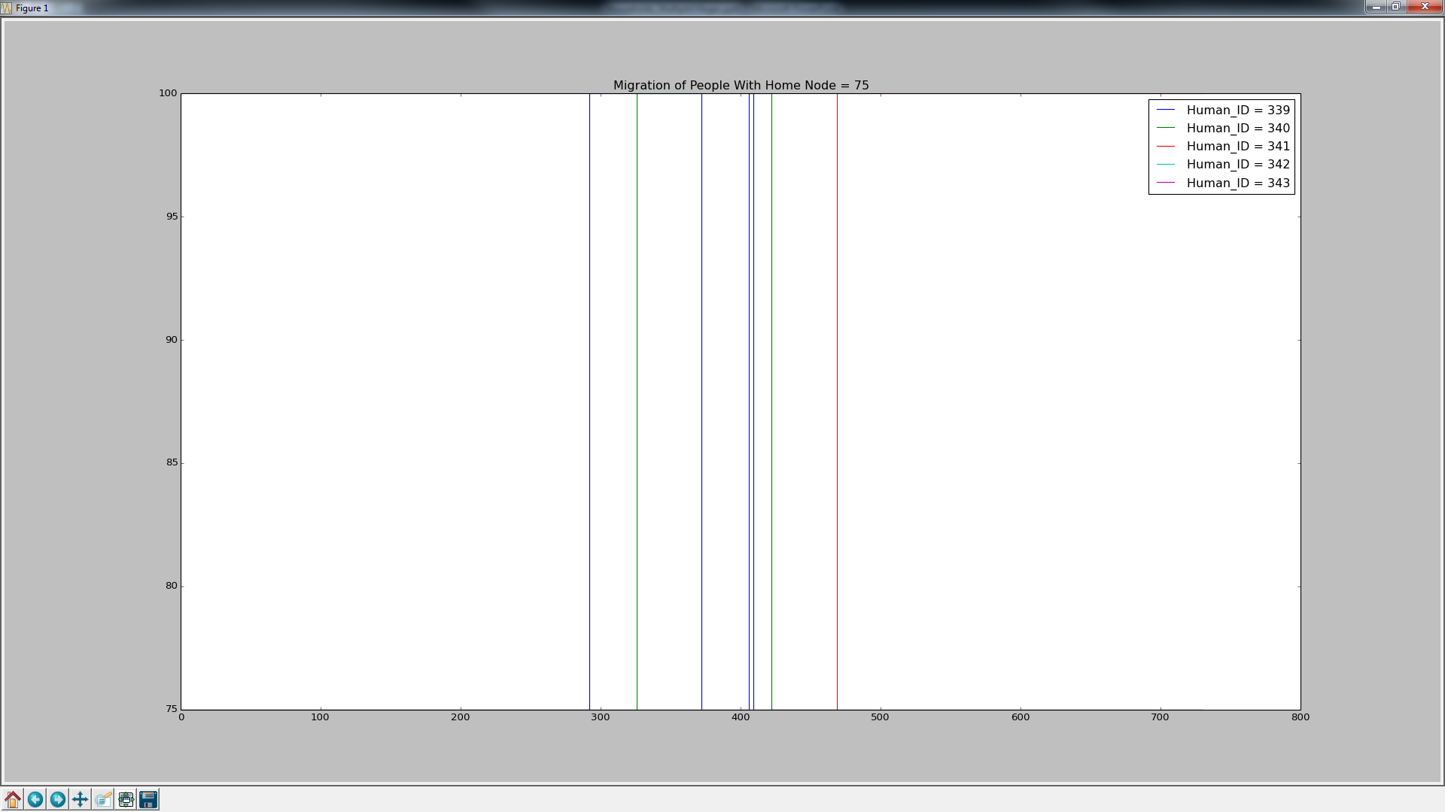
Human Migration For Node 75 Residents Sea Migration

Slide 23
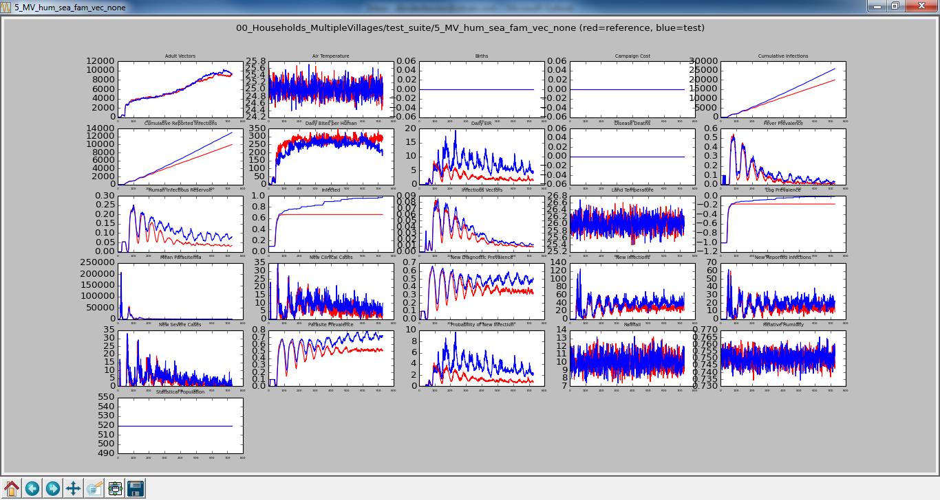
No Human/No Vector Migration vs Sea, Fam Human/No Vector Migration

Slide 24
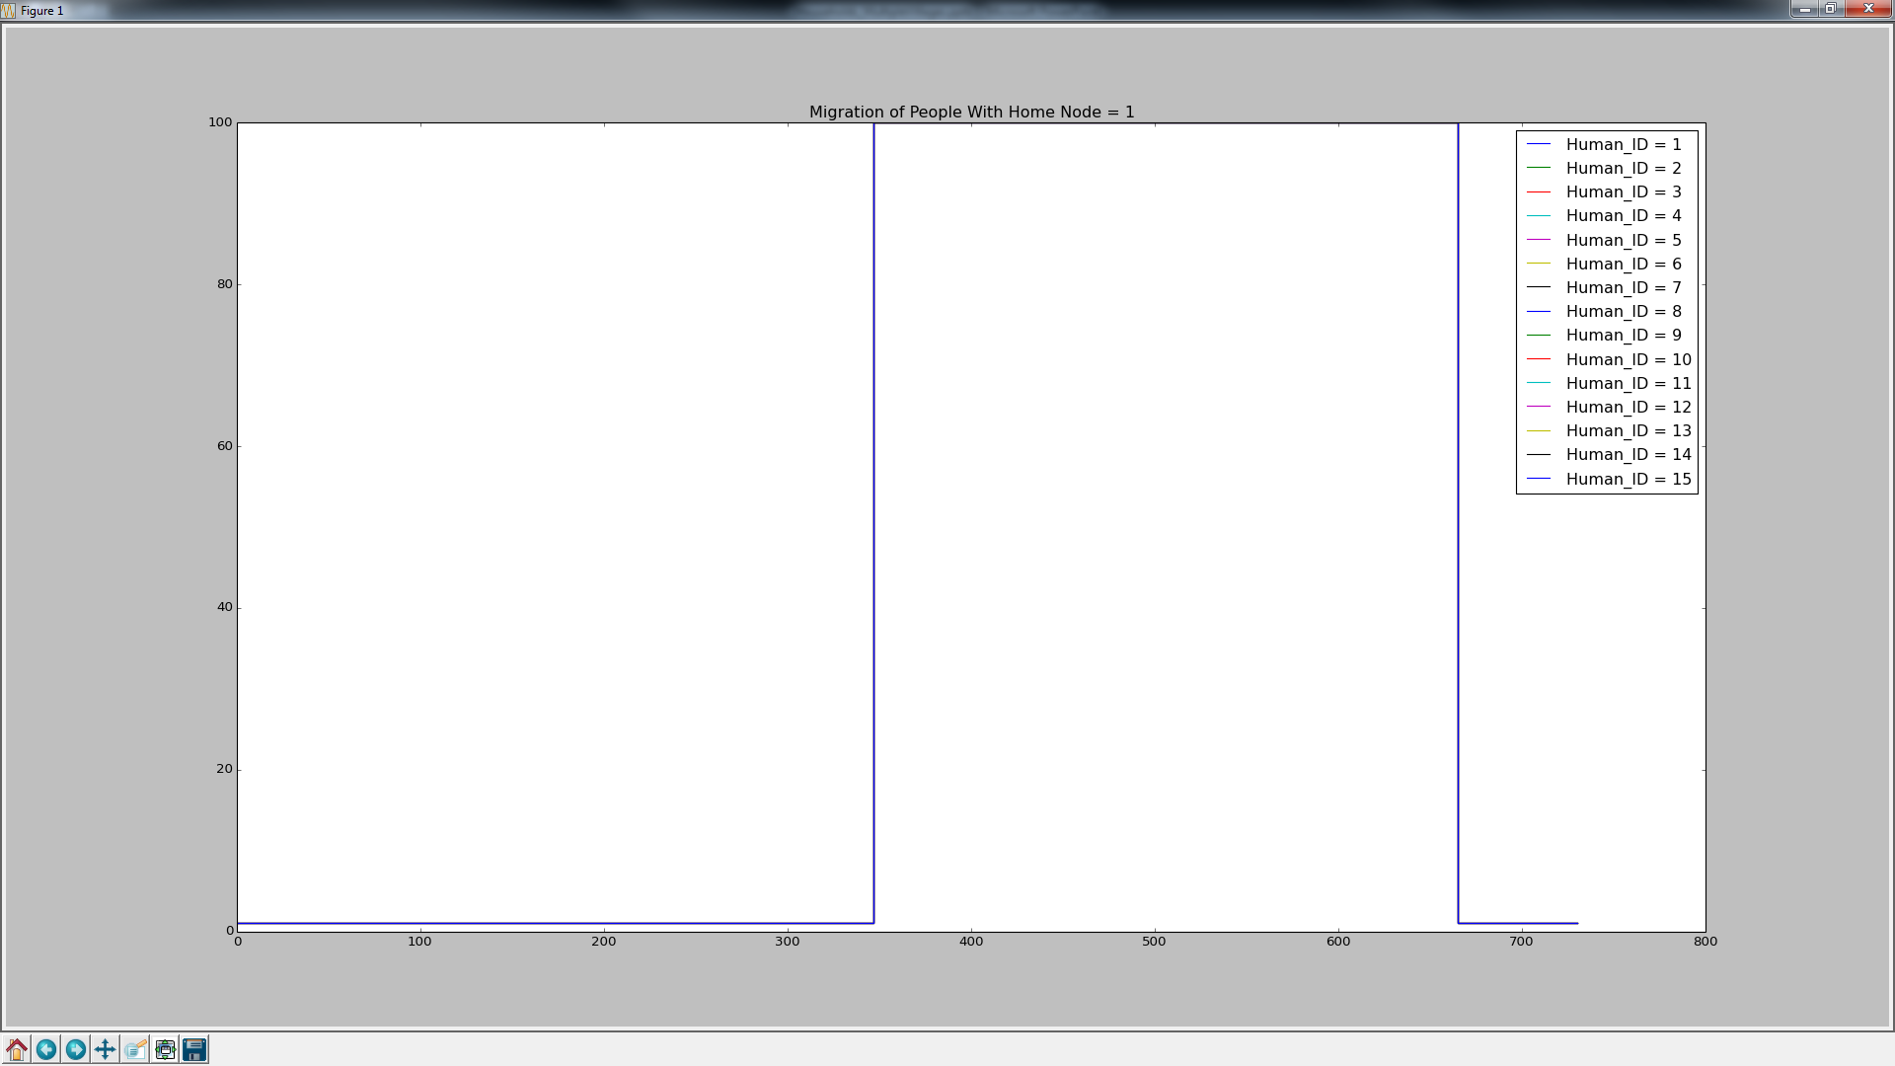
Human Migration For Node 1 Residents Sea, Family Migration

Slide 25
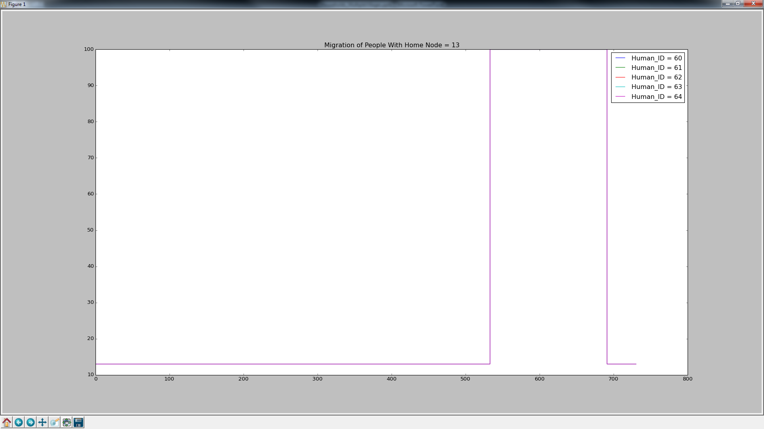
Human Migration For Node 13 Residents Sea, Family Migration

Slide 26
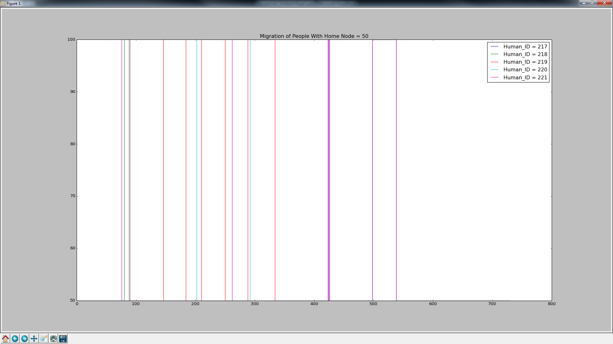
Human Migration For Node 50 Residents Sea, Family Migration

Slide 27
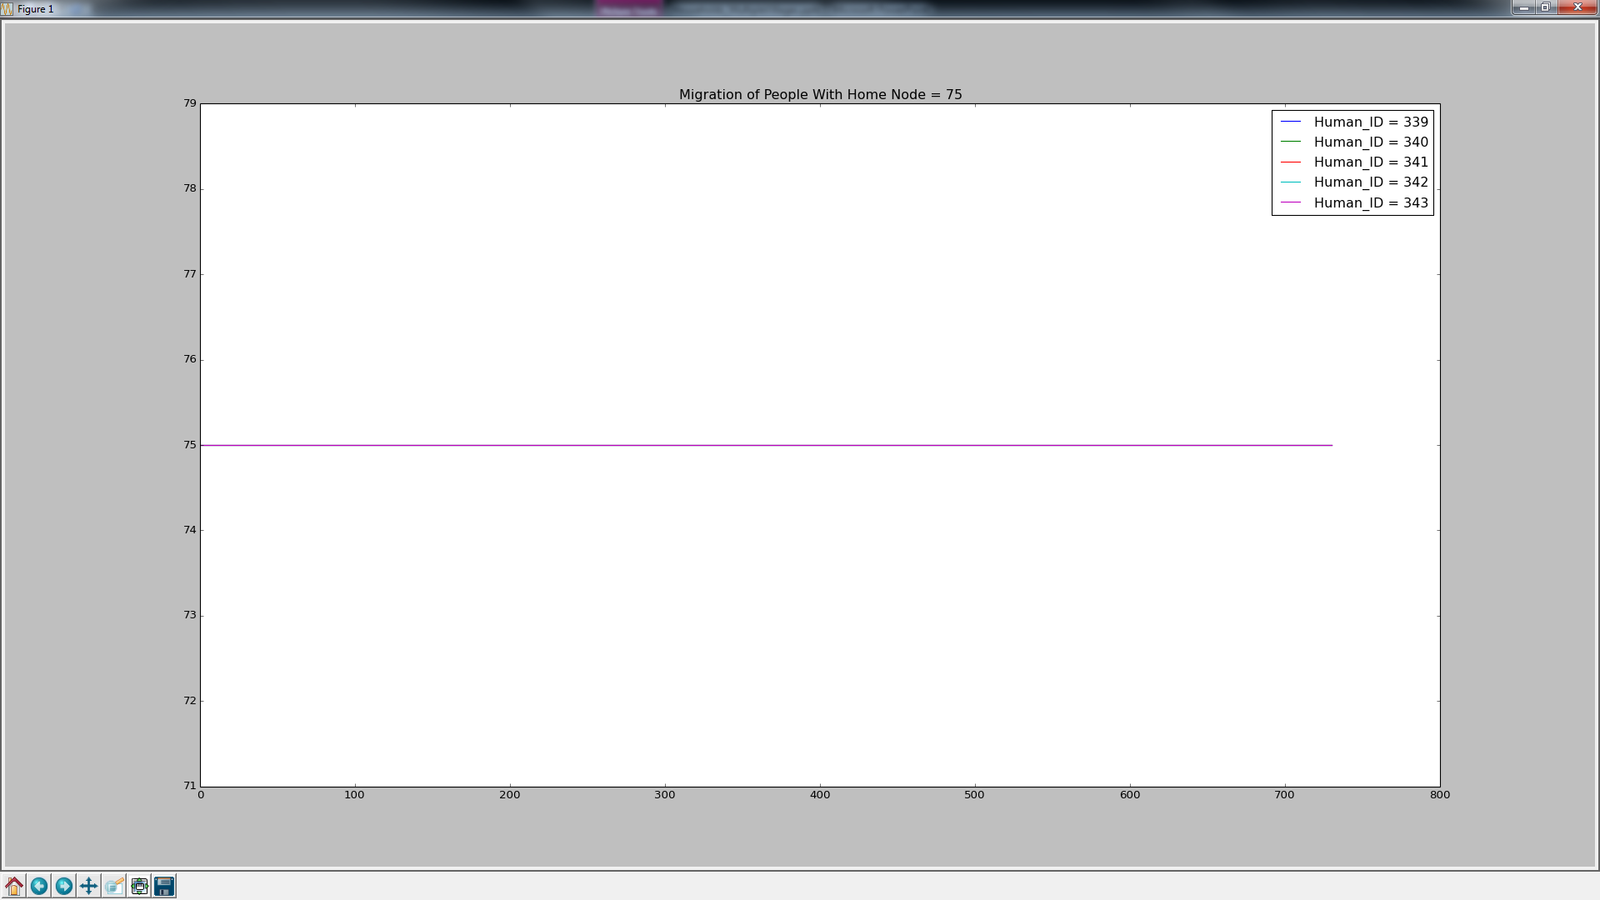
Human Migration For Node 75 Residents Sea, Family Migration

Slide 28
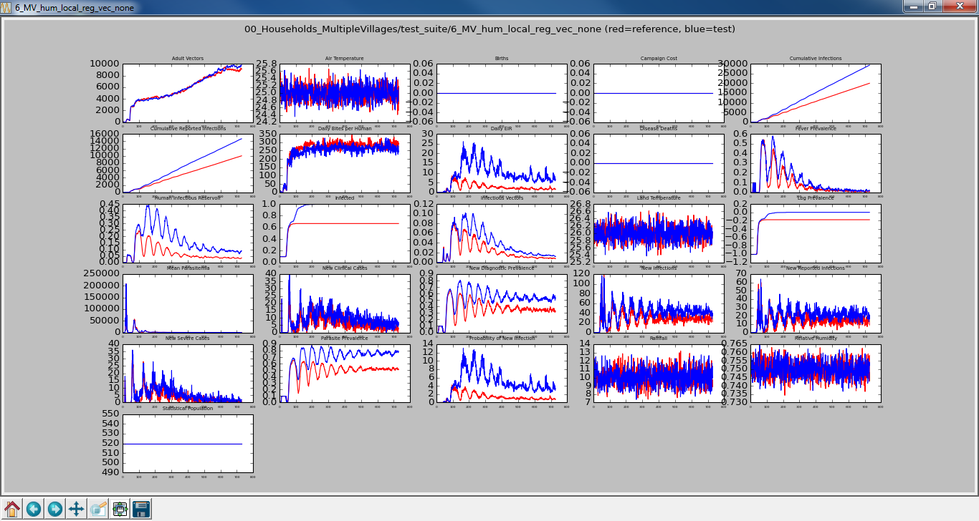
No Human/No Vector Migration vs Local, Regional Human/No Vector Migration

Slide 29
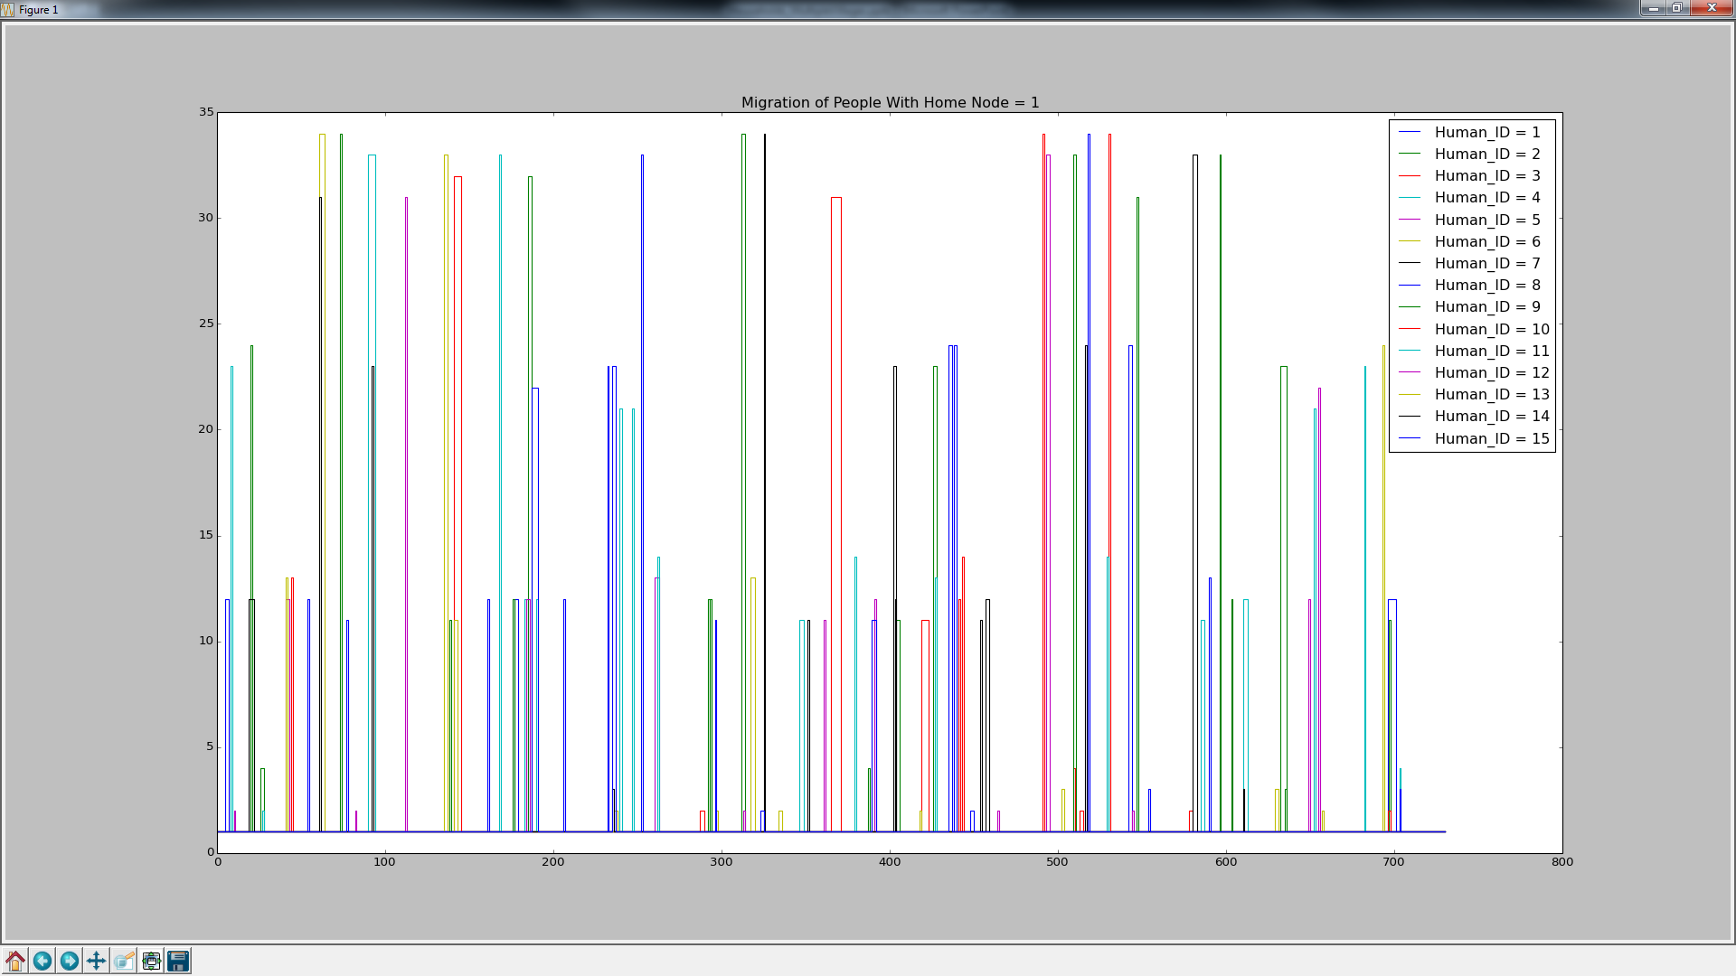
Human Migration For Node 1 Residents Local, Regional Migration
Habitat Boundary or Other Village
Adjacent Nodes

Slide 30
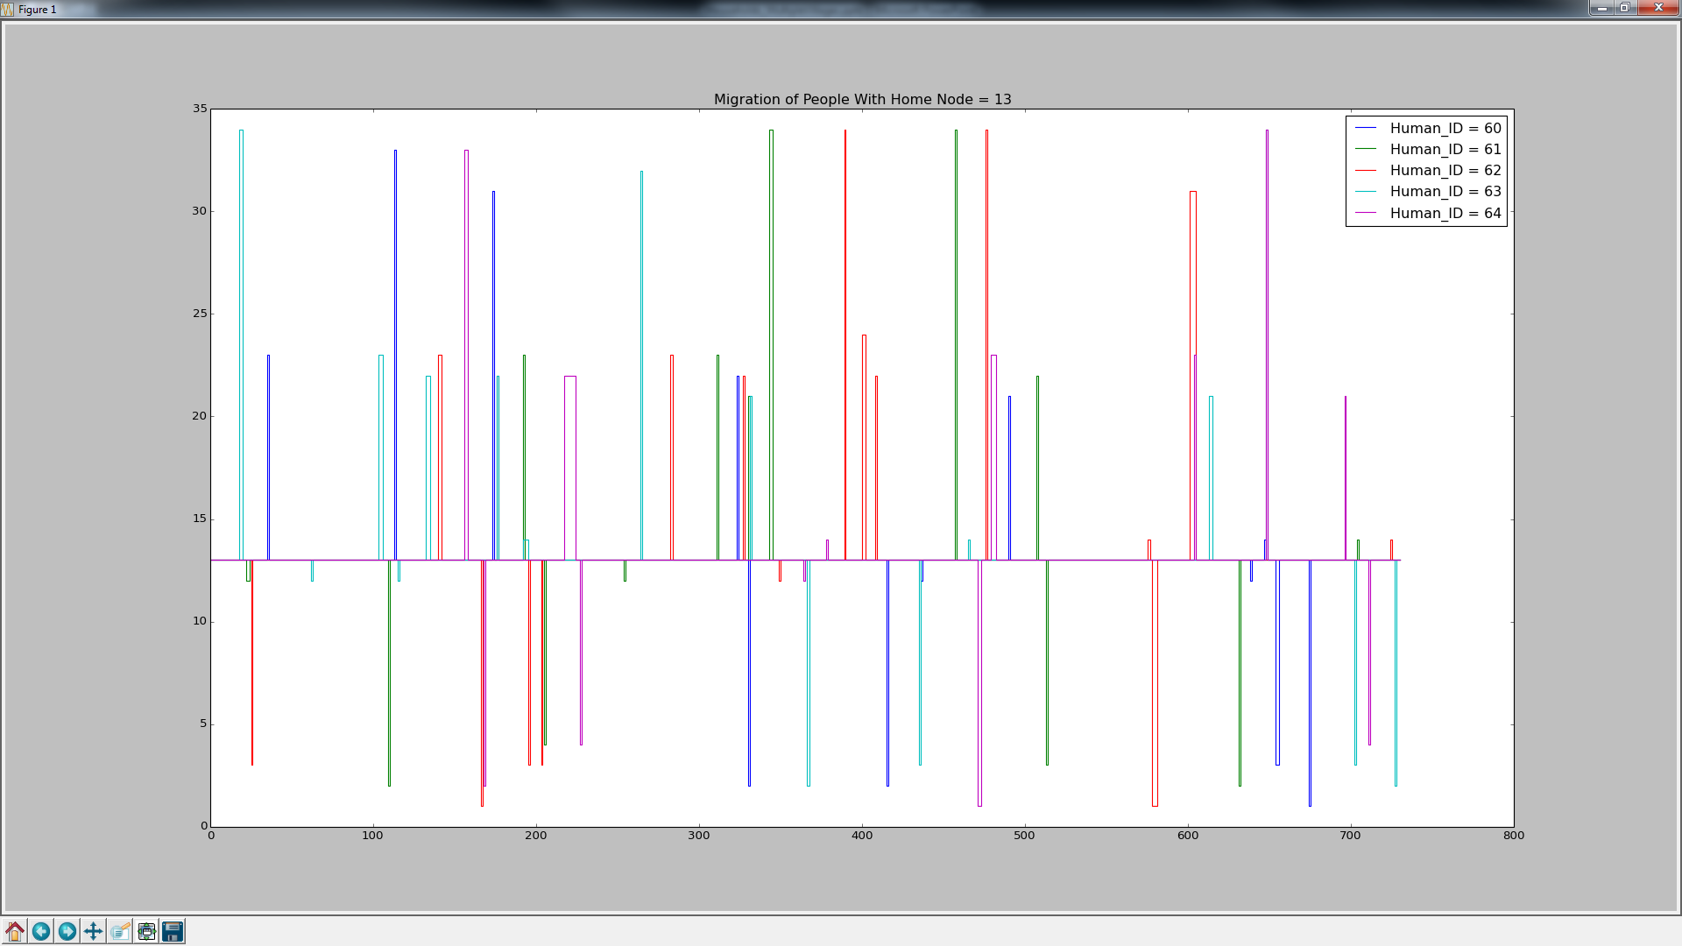
Human Migration For Node 13 Residents Local, Regional Migration
Habitat Boundary or Other Village
Adjacent Nodes

Slide 31
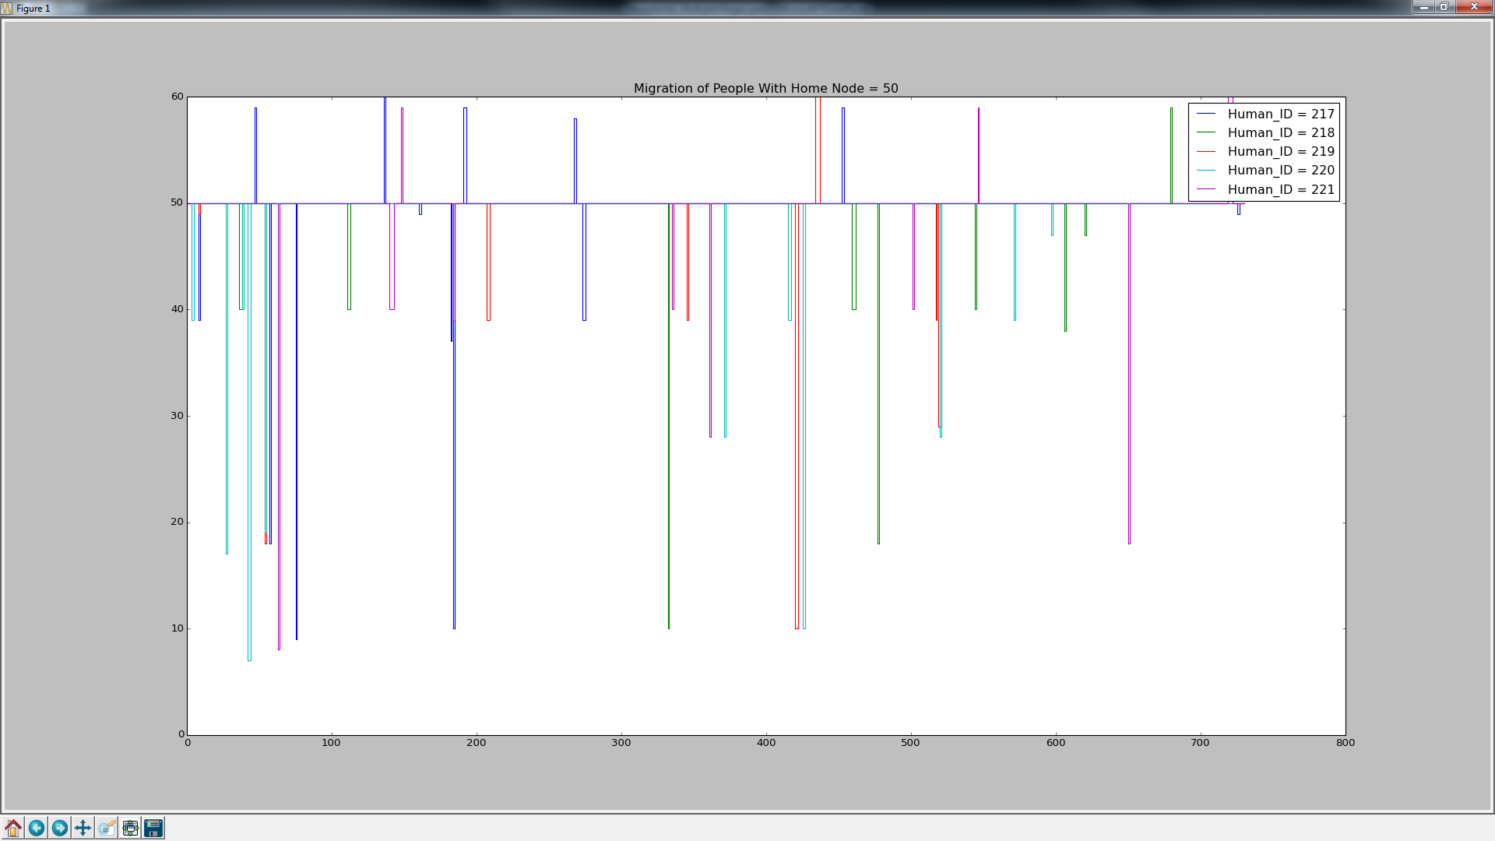
Human Migration For Node 50 Residents Local, Regional Migration
Habitat Boundary or Other Village
Adjacent Nodes

Slide 32
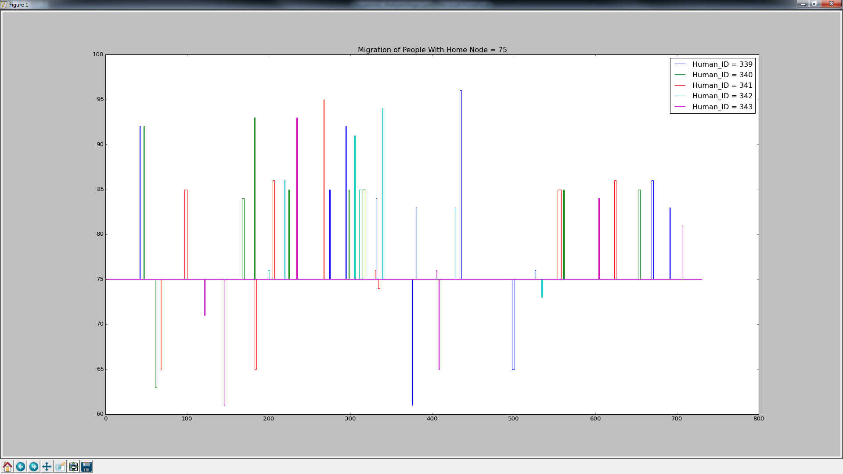
Human Migration For Node 75 Residents Local, Regional Migration
Habitat Boundary or Other Village
Adjacent Nodes

Slide 33
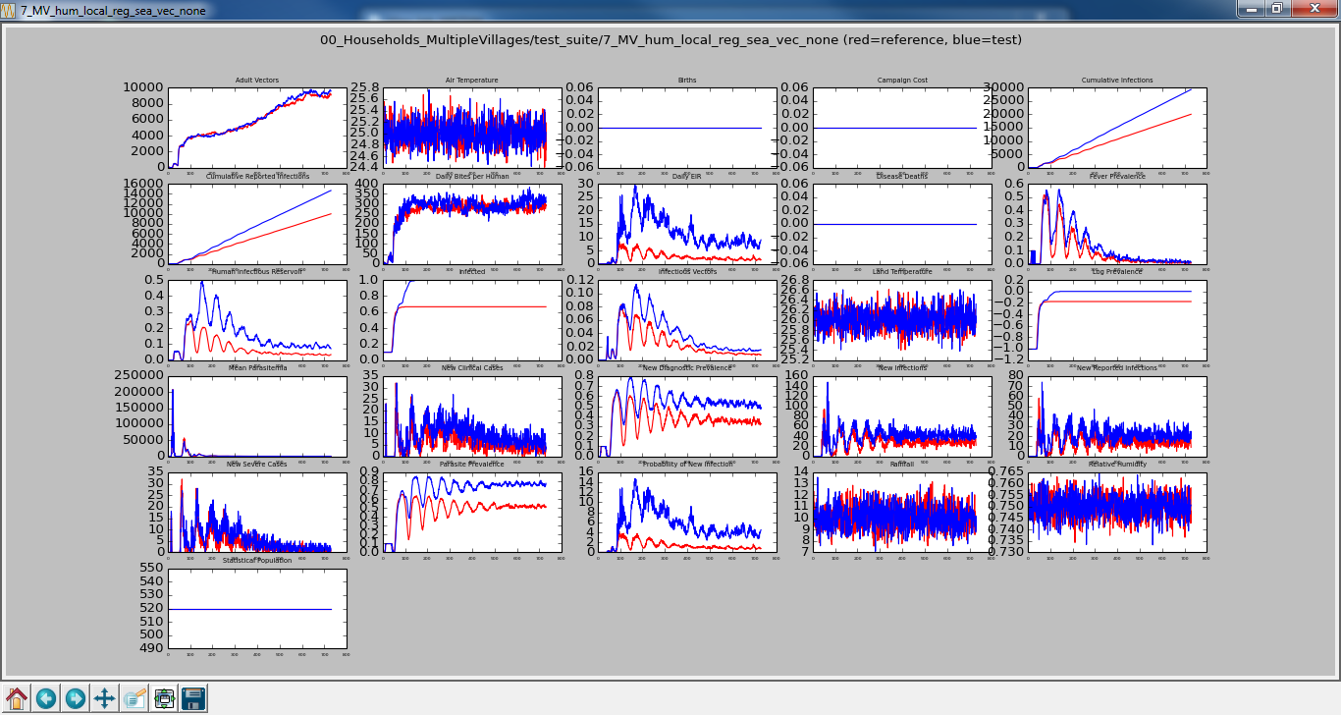
No Human/No Vector Migration vs Local, Regional, Sea Human/No Vector Migration

Slide 34
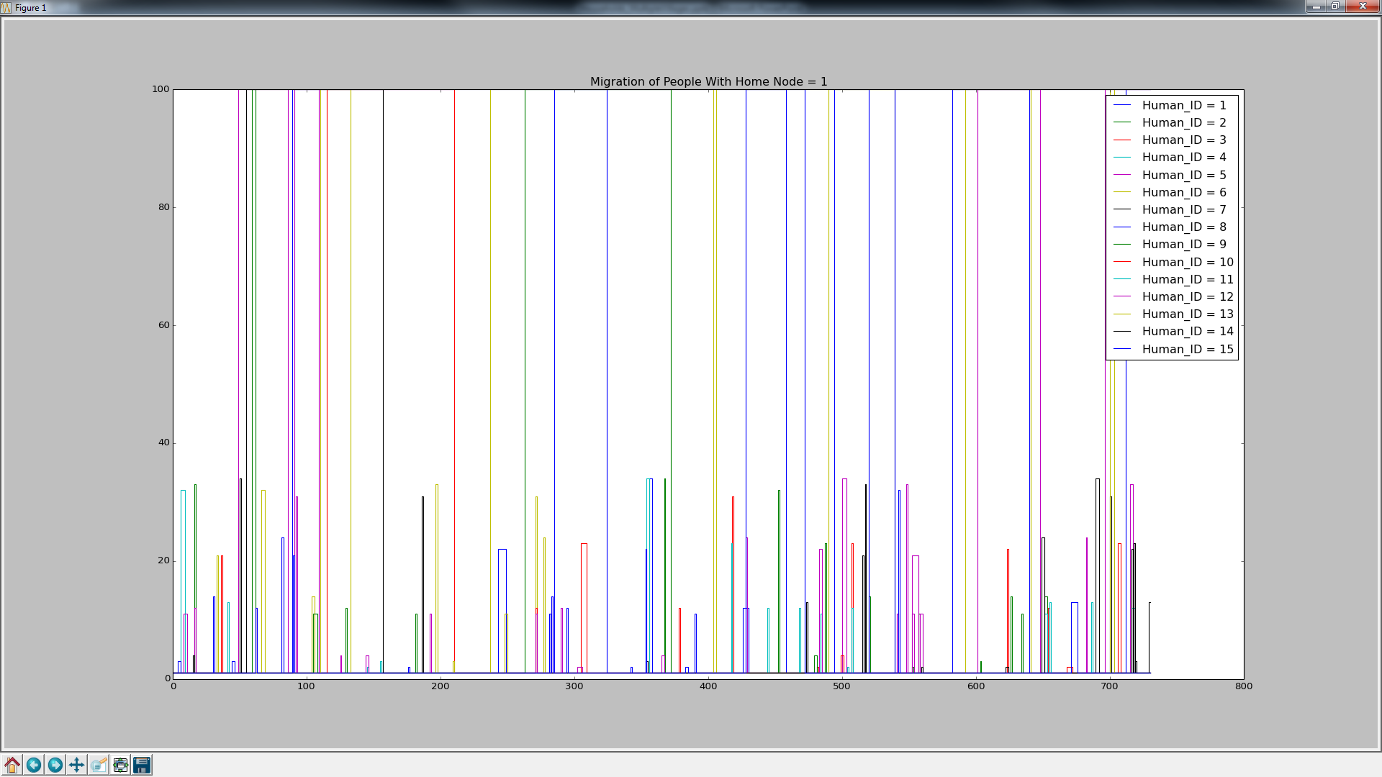
Human Migration For Node 1 Residents Local, Regional, Sea Migration
Habitat Boundary or Other Village
Adjacent Nodes

Slide 35
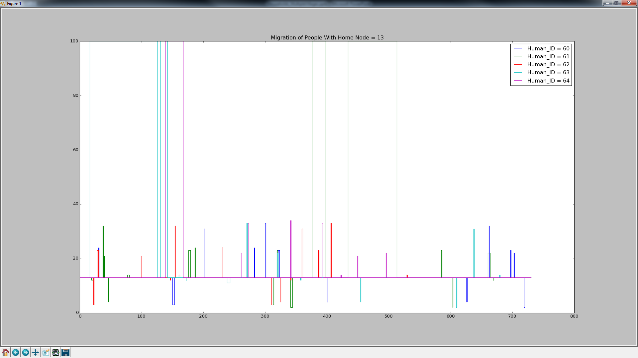
Human Migration For Node 13 Residents Local, Regional, Sea Migration
Habitat Boundary or Other Village
Adjacent Nodes

Slide 36
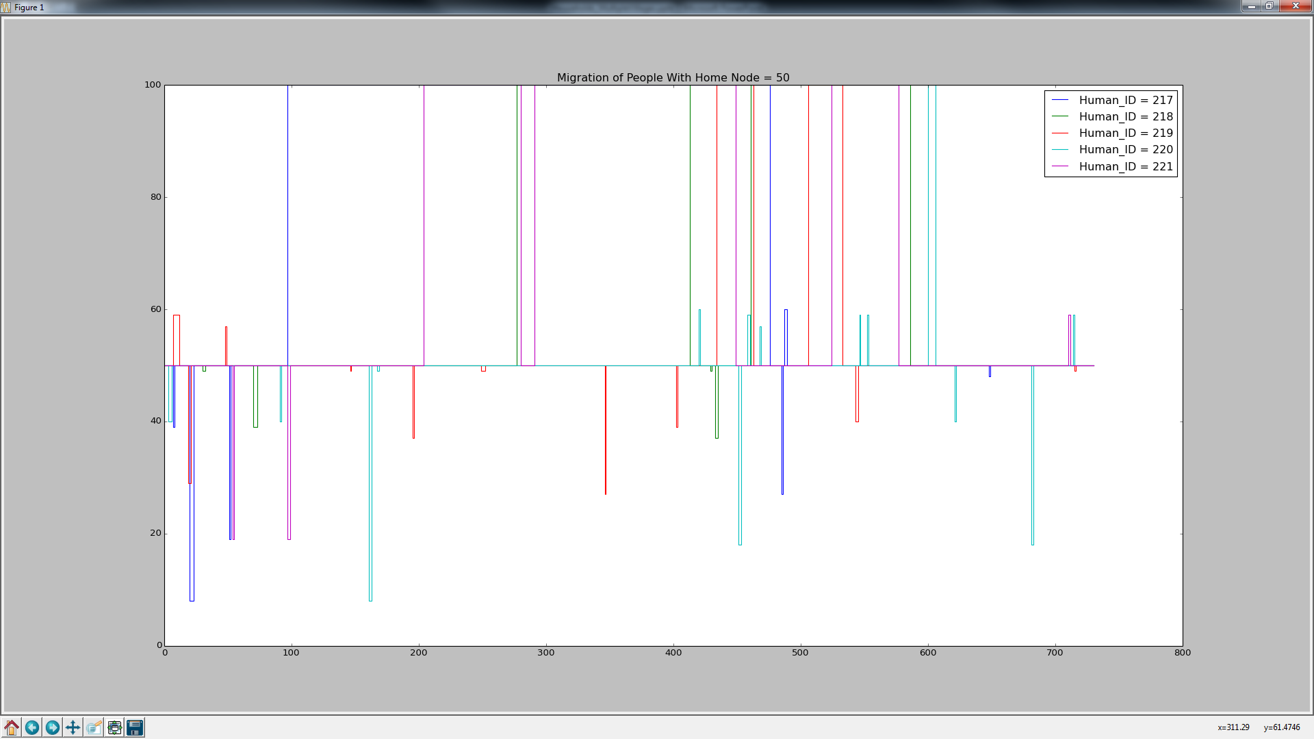
Human Migration For Node 50 Residents Local, Regional, Sea Migration
Habitat Boundary or Other Village
Adjacent Nodes

Slide 37
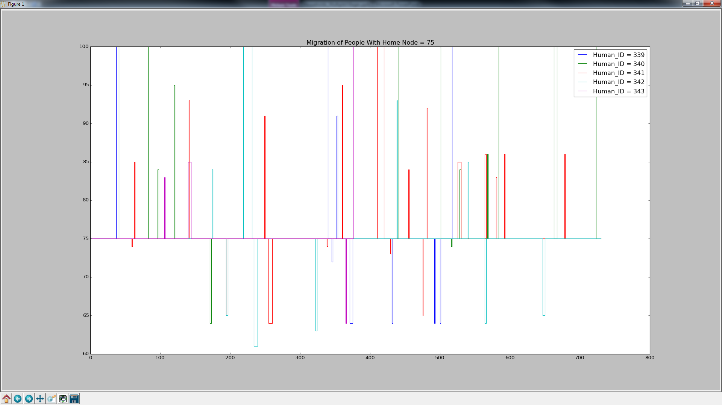
Human Migration For Node 75 Residents Local, Regional, Sea Migration
Habitat Boundary or Other Village
Adjacent Nodes

Slide 38

No Human/No Vector Migration vs Local, Regional, Sea, Family Human/No Vector Migration

Slide 39
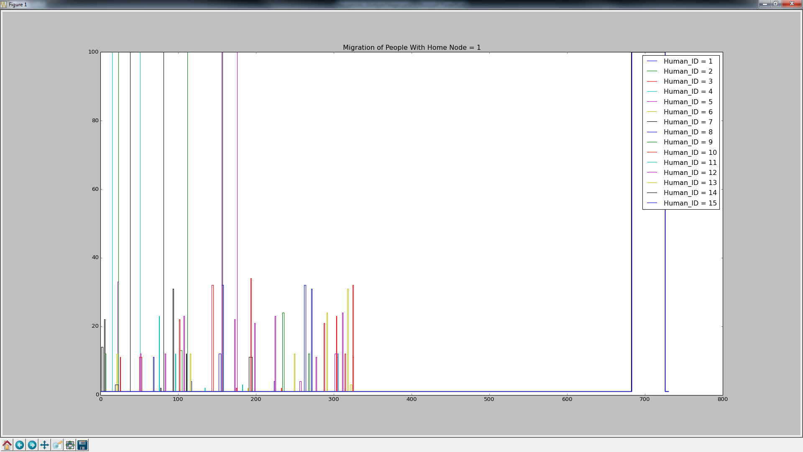
Human Migration For Node 1 Residents Local, Regional, Sea, Family Migration
Habitat Boundary or Other Village
Adjacent Nodes

Slide 40
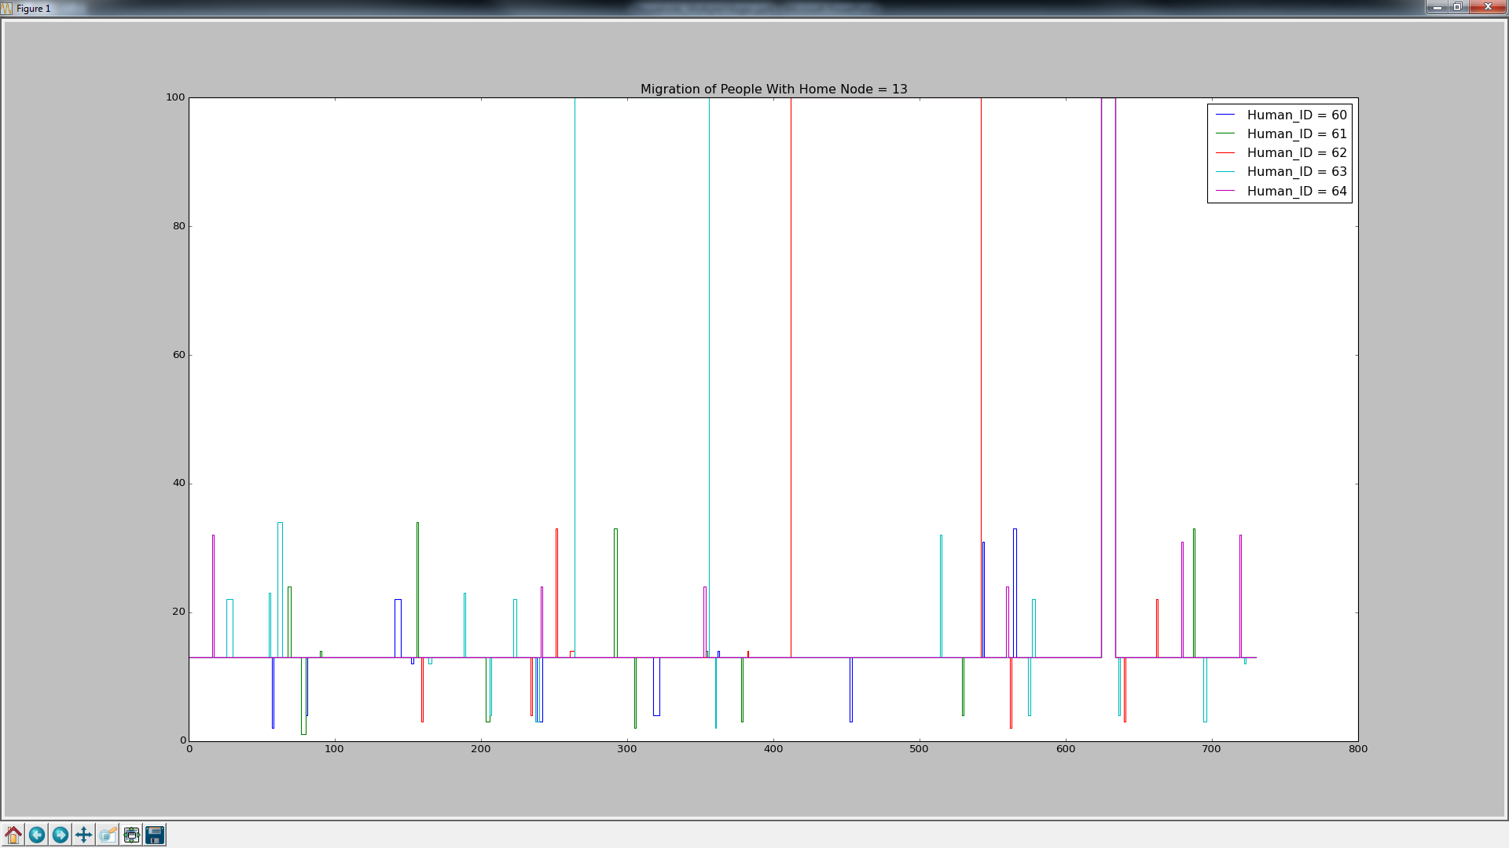
Human Migration For Node 13 Residents Local, Regional, Sea, Family Migration
Habitat Boundary or Other Village
Adjacent Nodes

Slide 41
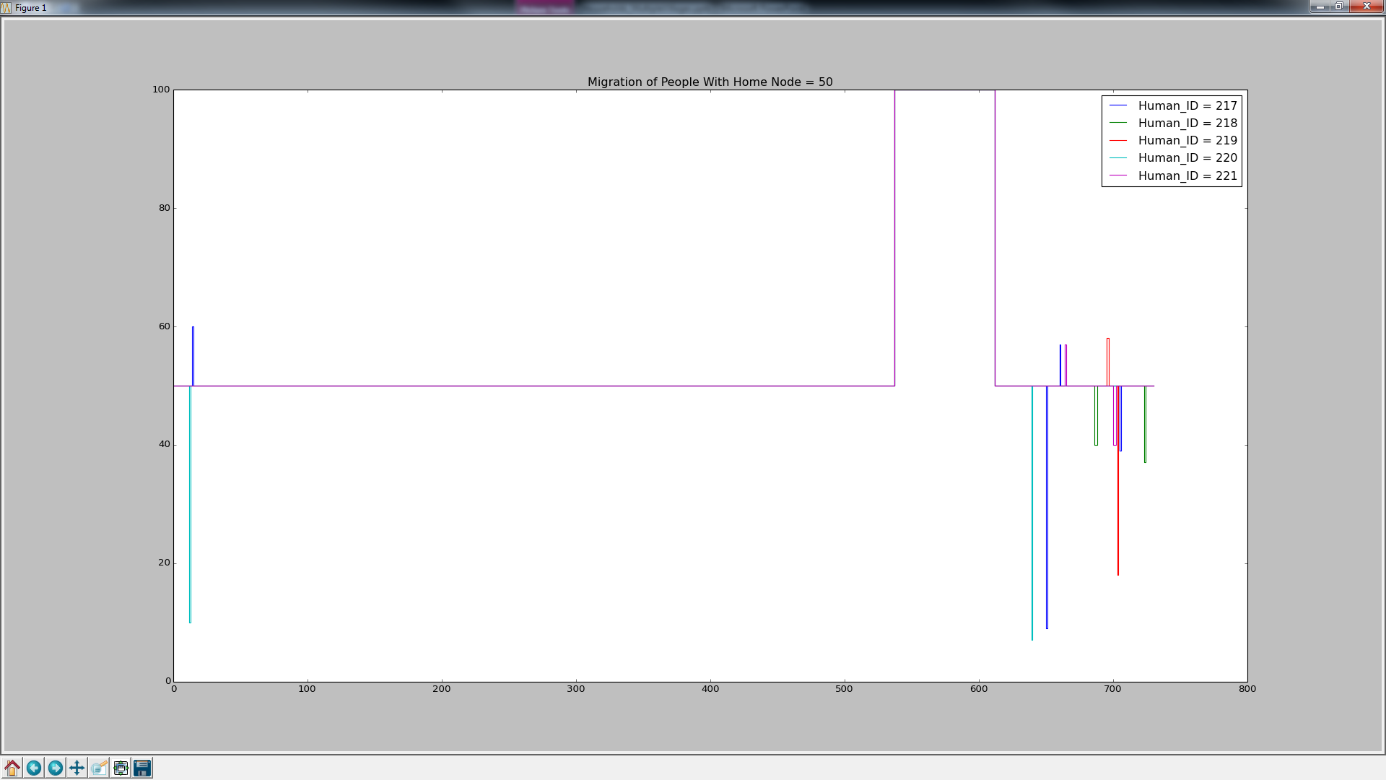
Human Migration For Node 50 Residents Local, Regional, Sea, Family Migration
Habitat Boundary or Other Village
Adjacent Nodes

Slide 42
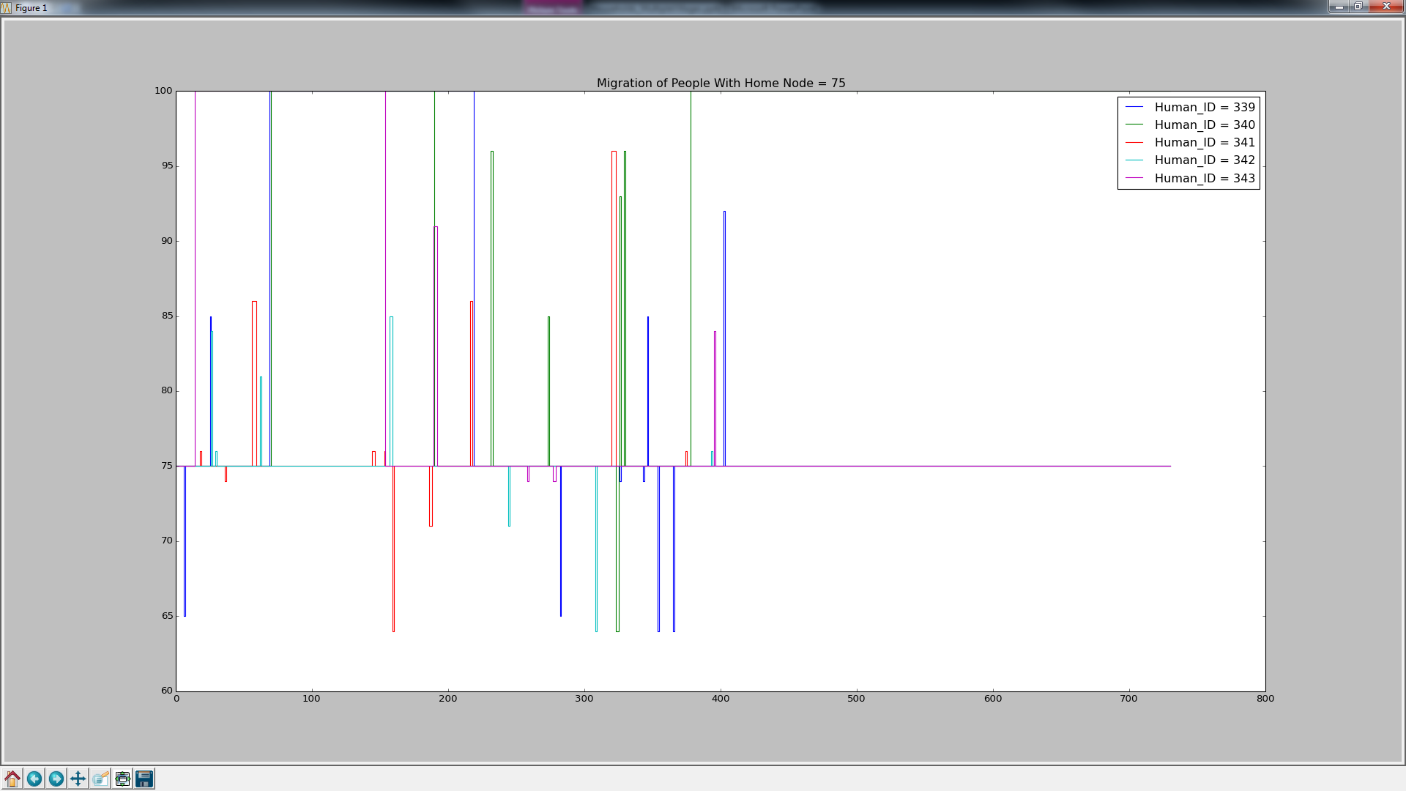
Human Migration For Node 75 Residents Local, Regional, Sea, Family Migration
Habitat Boundary or Other Village
Adjacent Nodes

Slide 43
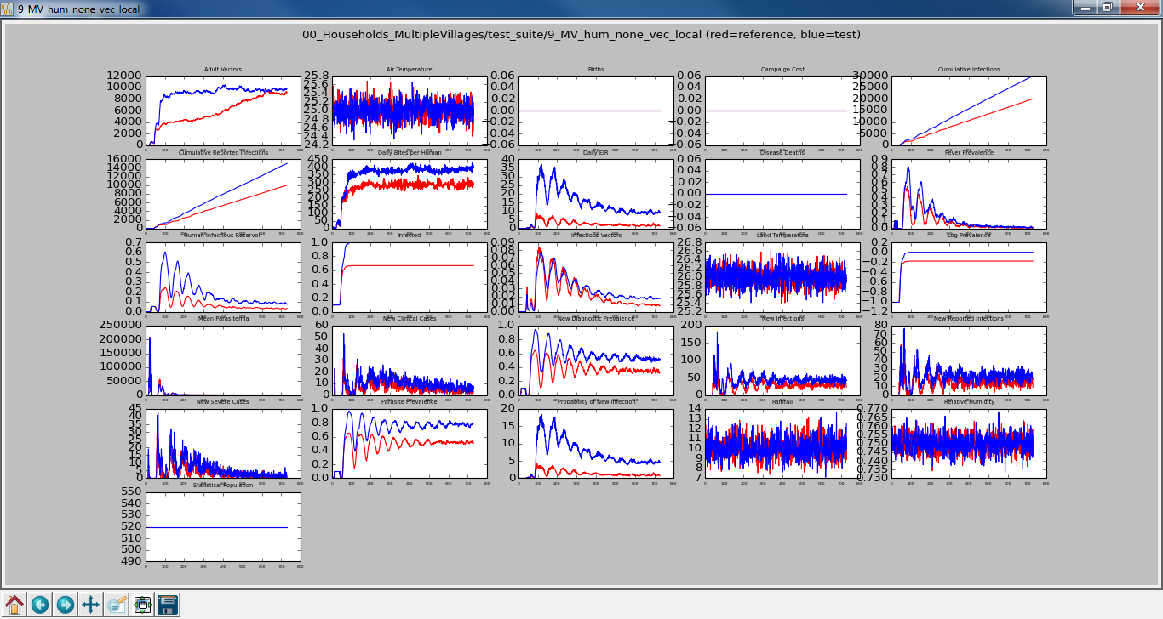
No Human/No Vector Migration vs No Human/Local Vector Migration

Slide 44
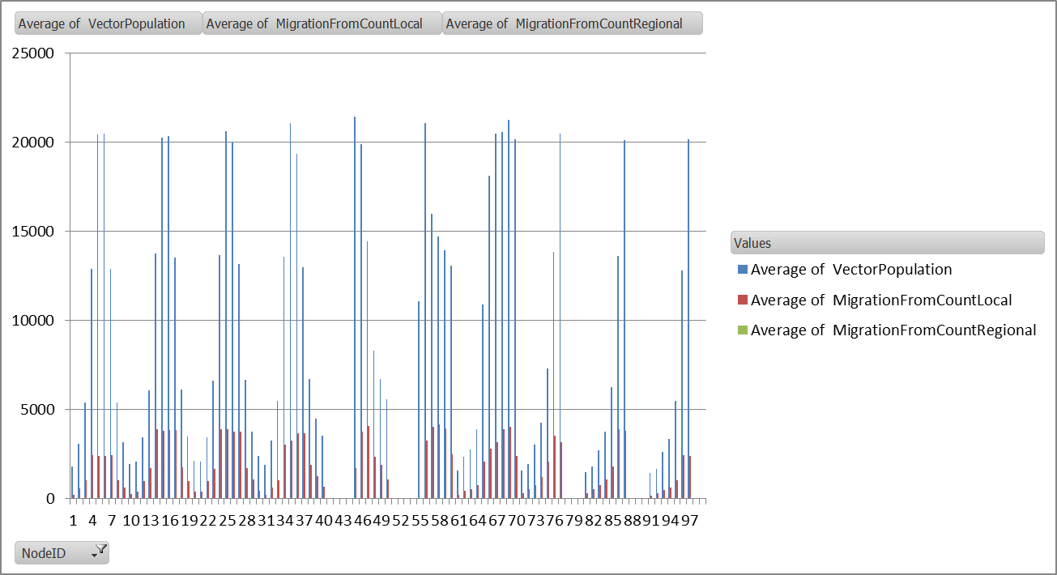
No Human/Local Vector Migration Average Vector Population & Local/Regional Migration From

Slide 45
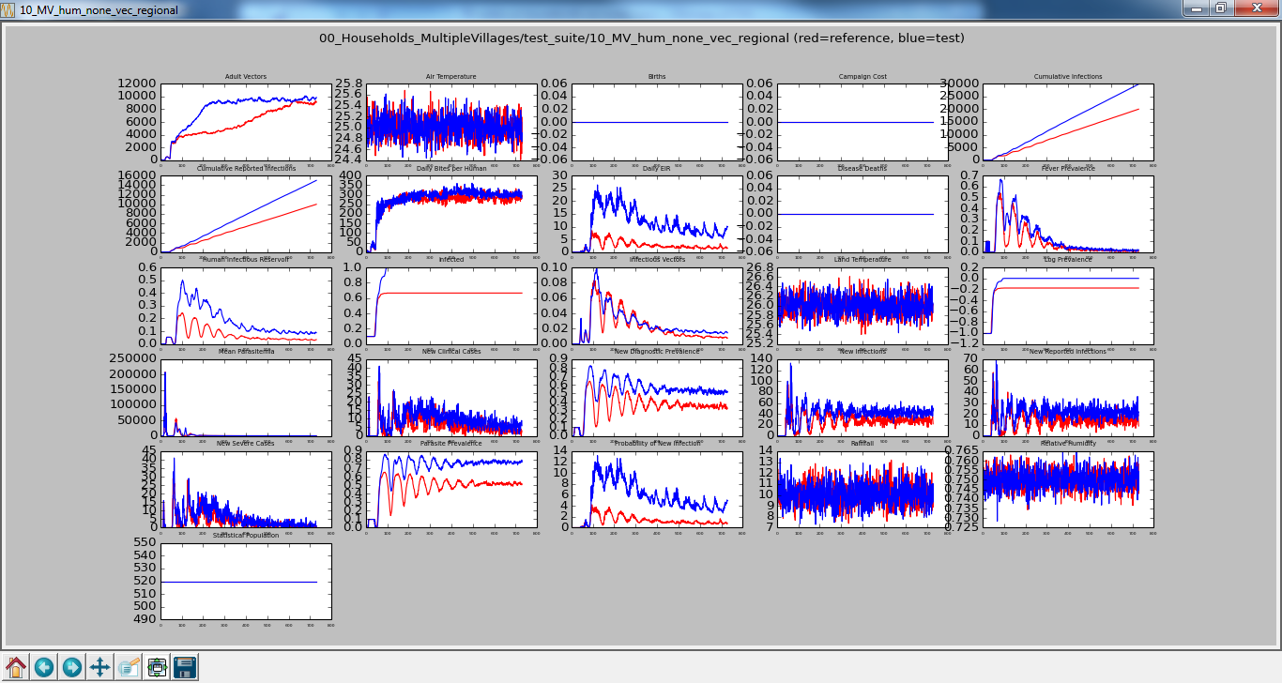
No Human/No Vector Migration vs No Human/Regional Vector Migration

Slide 46
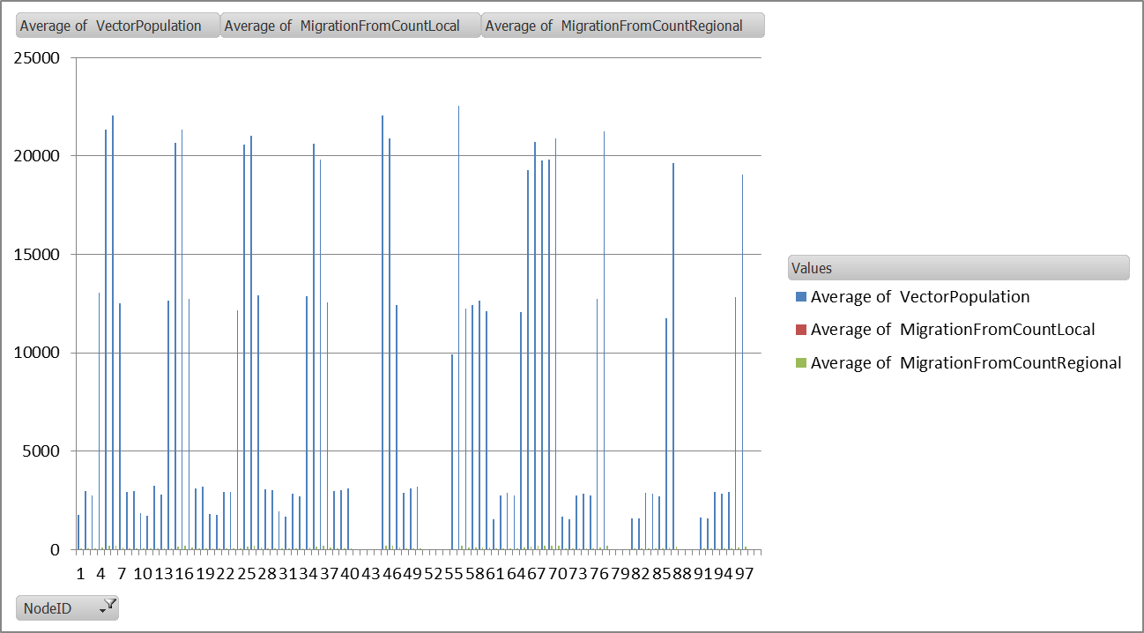
No Human/Regional Vector Migration Average Vector Population & Regional Migration From

Slide 47
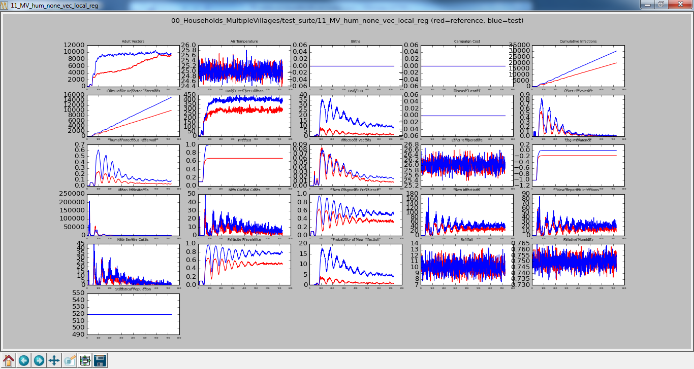
No Human/No Vector Migration vs No Human/Local, Regional Vector Migration

Slide 48
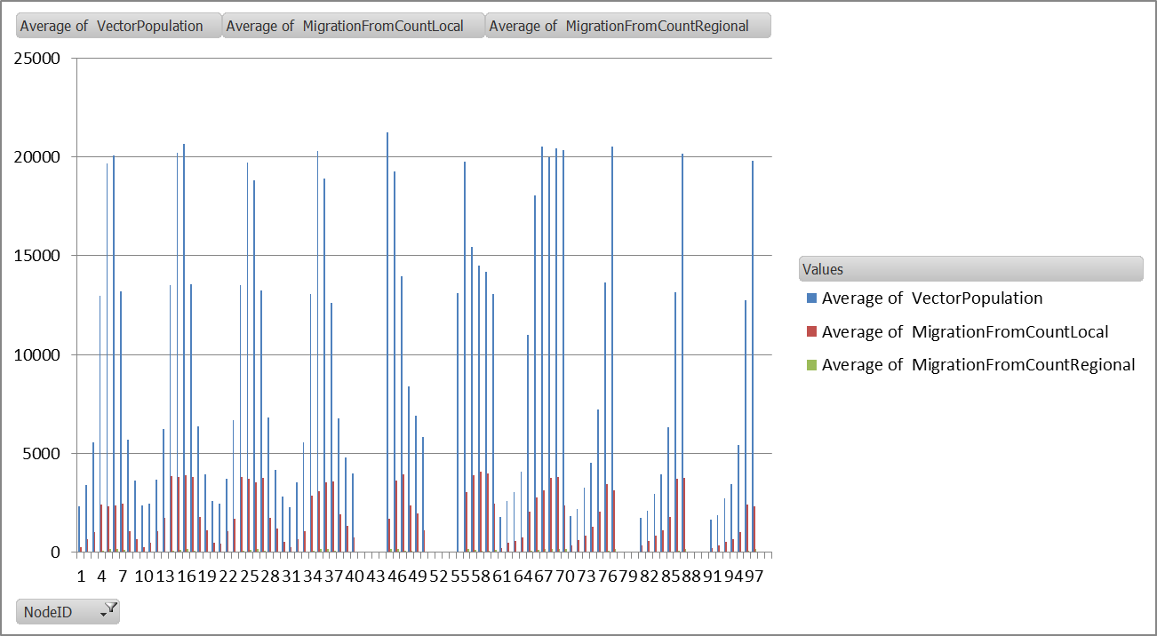
No Human/Local, Regional Vector Migration Average Vector Population & Local/Regional Migration From

Slide 49
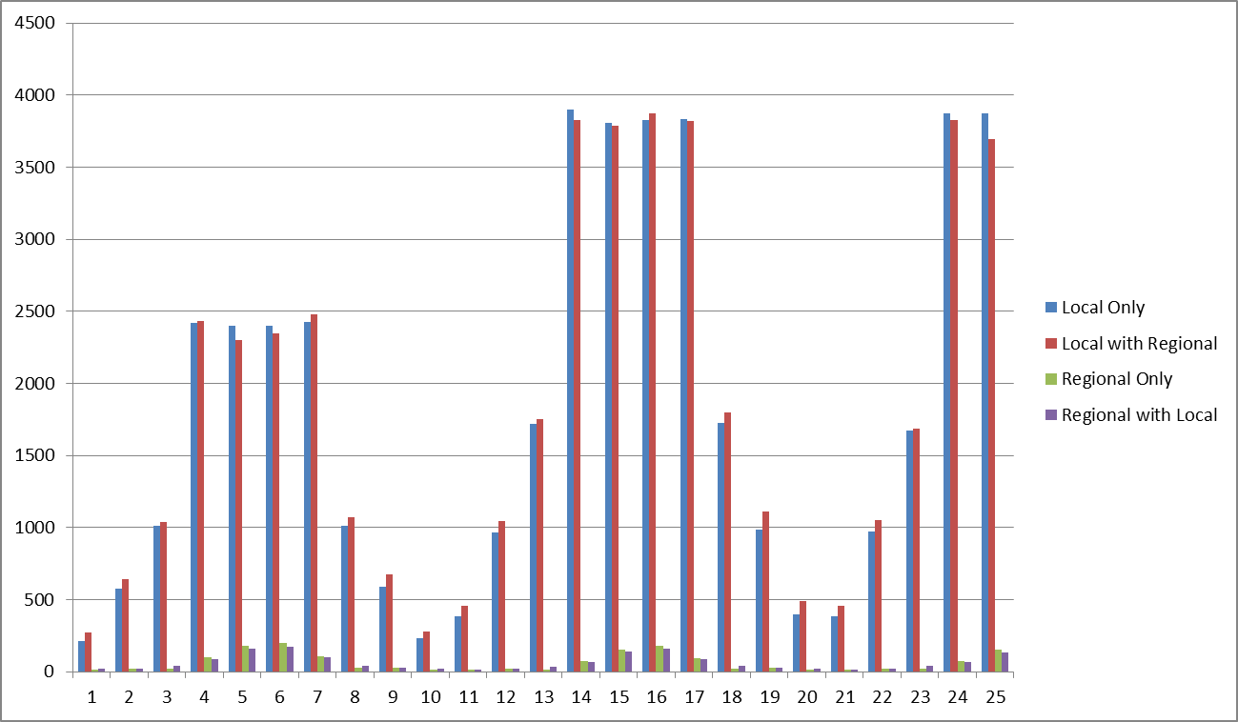
Average # of Vectors Migrating Locally/Regionally Per Day Per Node

Slide 50
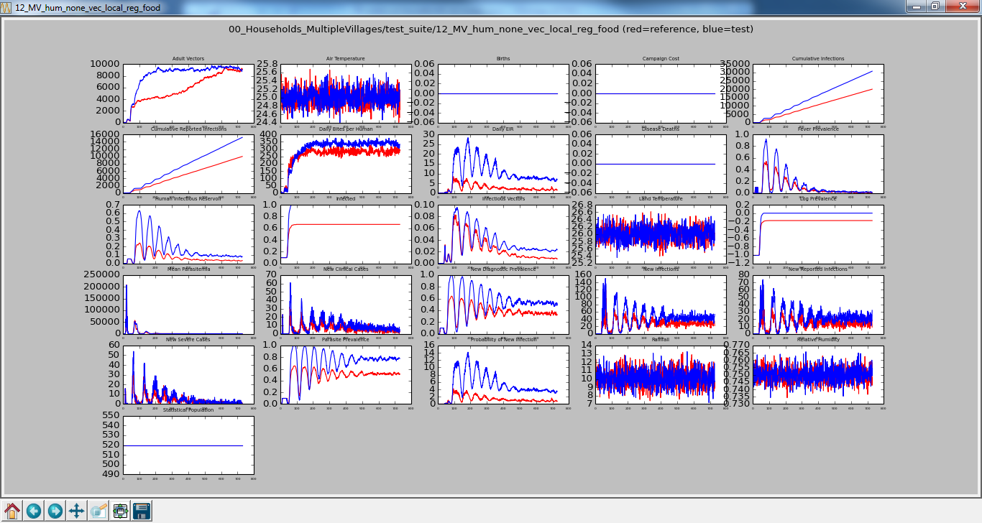
No Human/No Vector Migration vs No Human/Local, Regional, Food Vector Migration

Slide 51
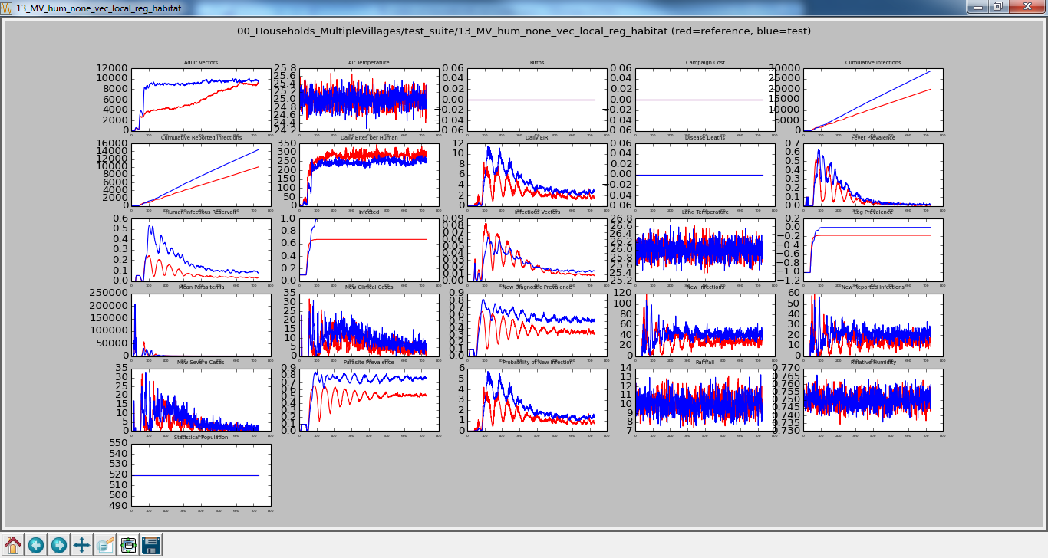
No Human/No Vector Migration vs No Human/Local, Regional, Habitat Vector Migration

Slide 52
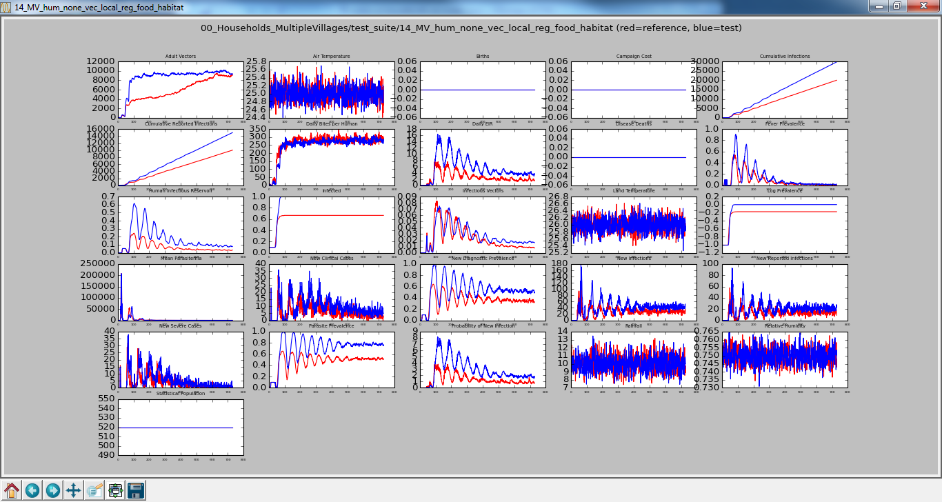
No Human/No Vector Migration vs No Human/Local, Regional, Food, Habitat Vector Migration

Slide 53

Vector Migration Modifiers Average Vector Population Vulcan

Slide 54

Vector Migration Modifiers Average Vector Population Kronos

Slide 55

Vector Migration Modifiers Average Vector Population Andoria

Slide 56

No Modifiers

Slide 57

Food=2

Slide 58

Habitat=4

Slide 59

Food=2 & Habitat=4

Slide 60

Food=4, Habitat=2

Slide 61

Outbreak None vs 10% of Everyone
Human Migration = Local, Regional, Sea Vector Migration = Local, Regional

Slide 62

Outbreak 10% of Everyone Vs 10% of Work Node (100)
Human Migration = Local, Regional, Sea Vector Migration = Local, Regional

Slide 63

Outbreak 10% of Everyone Vs 10% of Node 13
Human Migration = Local, Regional, Sea Vector Migration = Local, Regional

Slide 64

Outbreak 10% of Everyone Vs 10% of Node 57
Human Migration = Local, Regional, Sea Vector Migration = Local, Regional

Slide 65

Outbreak 10% of Everyone Vs 10% of Node 75
Human Migration = Local, Regional, Sea Vector Migration = Local, Regional

Slide 66

Starts in All Nodes

Slide 67

Starts in Node 100 (Earth)

Slide 68

Starts in Node 13 in Vulcan

Slide 69

Starts in Node 57 in Kronos

Slide 70

Starts in Node 75 in Andoria

Slide 71

Starts in Node 57 in Kronos No Vaccination vs Vaccinate Neighbors

Slide 72

Starts in Node 57 in Kronos No Vaccination vs Vaccinate Neighbors

Slide 73

Starts in Node 57 in Kronos Vaccinate Neighbors vs Plus Move Away From Infected House (MigrateTo)

Slide 74



Starts in Node 57 in Kronos Vaccinate Neighbors Plus Move Away From Infected House (MigrateTo)
T=48
57
T=276
T=367

Slide 75
Load Balance Scheme Json
Config.json parameter
"Load_Balance_Filename": "Load_Balance_4_cores.json"
File format
Results
{
"Load_Balance_Scheme_Nodes_On_Core_Matrix" :
[
[1,2,3,4,5,11,12,13,14,15,21,22,23,24,25,31,32,33,34,35,45],
[6,7,8,9,10,16,17,18,19,20,26,27,28,29,30,36,37,38,39,40,46,47,48,49,50,56,57,58,59,60,67,68,69,70],
[61,62,63,64,65,66,71,72,73,74,75,76,77,81,82,83,84,85,86,87,91,92,93,94,95,96,97],
[41,42,43,44,51,52,53,54,55,78,79,80,88,89,90,98,99,100]
]
}
Core
External Node IDs
 | 1-Core | 4-Cores Checkerboard | 4-Cores JSON
20_MV_hum_local_reg_sea_vec_local_reg_outbreak_75 | 5:55 | 10:58 | 3:12

Slide 76
Updates
10/16/2015
Due to Jaline’s survey of research papers on vector migration, she requested that we change our modifiers.
Habitat should just be based on Current Larval Capacity and not to take Larval Count into account.
Previously, we took the Current Larval Capacity minus the number of larva

Slide 77

23_MV_hum_none_vec_local_reg_food

Slide 78

24_MV_hum_none_vec_local_reg_habitat

Slide 79

25_MV_hum_none_vec_local_reg_food_habitat

Slide 80

23_MV_hum_none_vec_local_reg_food Average Vector Population Before vs After

Slide 81

24_MV_hum_none_vec_local_reg_habitat Average Vector Population Before Vs After

Slide 82

25_MV_hum_none_vec_local_reg_food_habitat Average Vector Population Before vs After

Slide 83


23_MV_hum_none_vec_local_reg_food Average Vector Population Before vs After
Before
After

Slide 84


24_MV_hum_none_vec_local_reg_habitat Average Vector Population Before Vs After
Before
After

Slide 85


25_MV_hum_none_vec_local_reg_food_habitat Average Vector Population Before vs After
Before
After

Slide 86
Backups

Slide 87

No Human/No Vector Migration – Outbreak 10% Everyone Vs Human Local, Regional, Sea Migration & Vector Local, Regional Migration Outbreak – 10% Work Node (100)

Slide 88

Outbreak None vs 10% of Work Node (100)
Human Migration = Local, Regional, Sea Vector Migration = Local, Regional

Slide 89

Food=4

Slide 90

Habitat=2

Slide 91

Food=4, Habitat=2

Slide 92

Food=4

Slide 93

Habitat=2

Slide 94

No Human/No Vector Migration – Outbreak 10% Everyone Vs Human Local, Regional, Sea Migration & Vector Local, Regional Migration Outbreak - None

Slide 95

Outbreak None vs 10% of Everyone
Human Migration = Local, Regional, Sea Vector Migration = Local, Regional

Slide 96

Outbreak 10% of Everyone Vs 10% of Work Node (100)
Human Migration = Local, Regional, Sea Vector Migration = Local, Regional

Slide 97

Outbreak 10% of Everyone Vs 10% of Node 13
Human Migration = Local, Regional, Sea Vector Migration = Local, Regional

Slide 98

Outbreak 10% of Everyone Vs 10% of Node 57
Human Migration = Local, Regional, Sea Vector Migration = Local, Regional

Slide 99

Outbreak 10% of Everyone Vs 10% of Node 75
Human Migration = Local, Regional, Sea Vector Migration = Local, Regional

